Slide 1
Tire Tank Installation Allen Shumate’s Demonstration Farm Paid for in part with Grants to Districts FY2015 funds provided by Arkansas Natural Resources Commission
This slideshow if for informational purposes. Never construct a tire tank under a NRCS contract (for cost share) without consulting with NRCS for technical specifications and other assistance.

Slide 2
Watering Facilities using recycled tires and inexpensive materials
The USDA-NRCS is a division of the federal government that provides technical and financial assistance for approved watering facilities.
Watering facilities include traditional tanks such as steel sidewall and freeze proof, plastic tanks.
Alternative watering facilities include recycled truck tires that are modified to provide a cheap water source.
NRCS funded tire tanks must be constructed according to a practice standard that specifies a minimum size, etc. (see slides below).
This slide show will provide information for NRCS-approved tanks.
We will also show two alternative tanks that are cheap, easily constructed and effective. These are Stacked Tractor tire tanks and culvert tanks.
Our alternative tanks, while cheap and effective are NOT approved for cost share by NRCS.

Slide 3
NRCS approved water tank installation Please consult with NRCS prior to starting any cost-shared practices

Slide 4
You may want to install a 3 inch overflow pipe to drain away excess water. A tire is placed over these two pipes as above.
Note: this supply pipe is very small.

Slide 5
Level the tank site.
Note the Water Supply Pipe. Here the pipe is 2 inch because this system is gravity flow/low pressure. No overflow drain pipe is present.

Slide 6
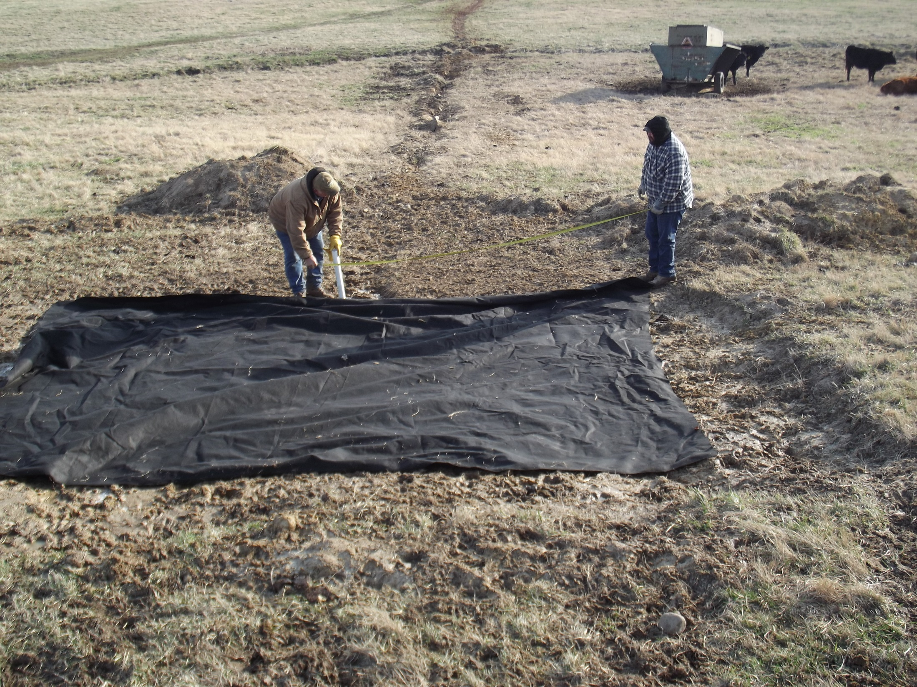
Place heavy duty filter fabric on leveled tank site.
Adding stones on top of the fabric will make a Heavy Use Area.

Slide 7
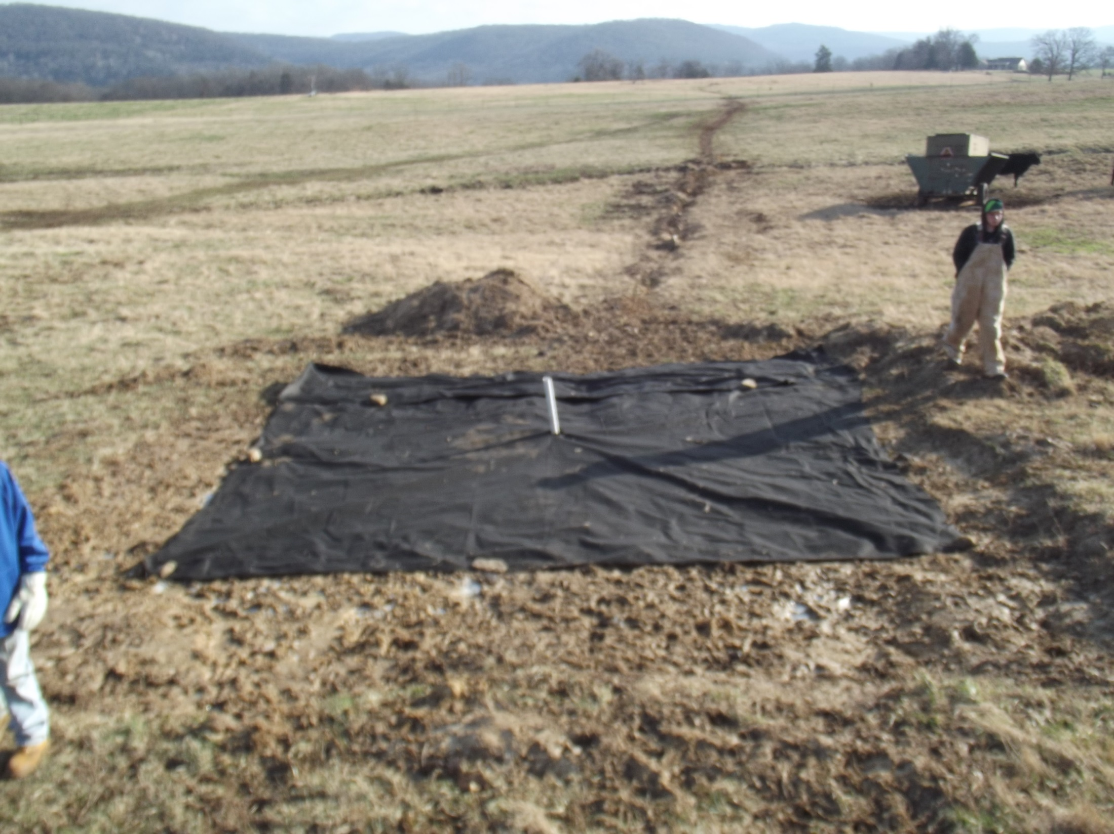
POND
Pipe trench

Slide 8
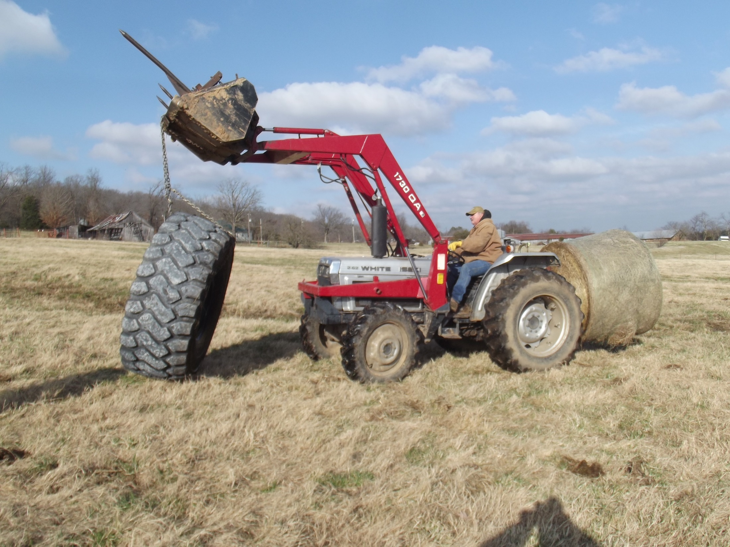
Adding a Cross Bar to the inside of the tank would make it easier to handle this tire.

Slide 9
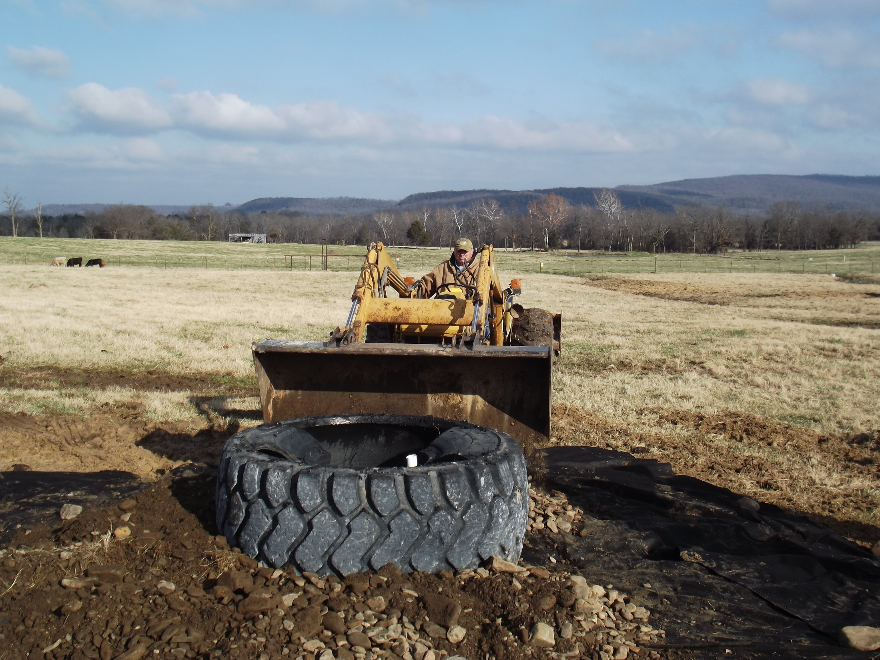
Positioning the tire tank

Slide 10
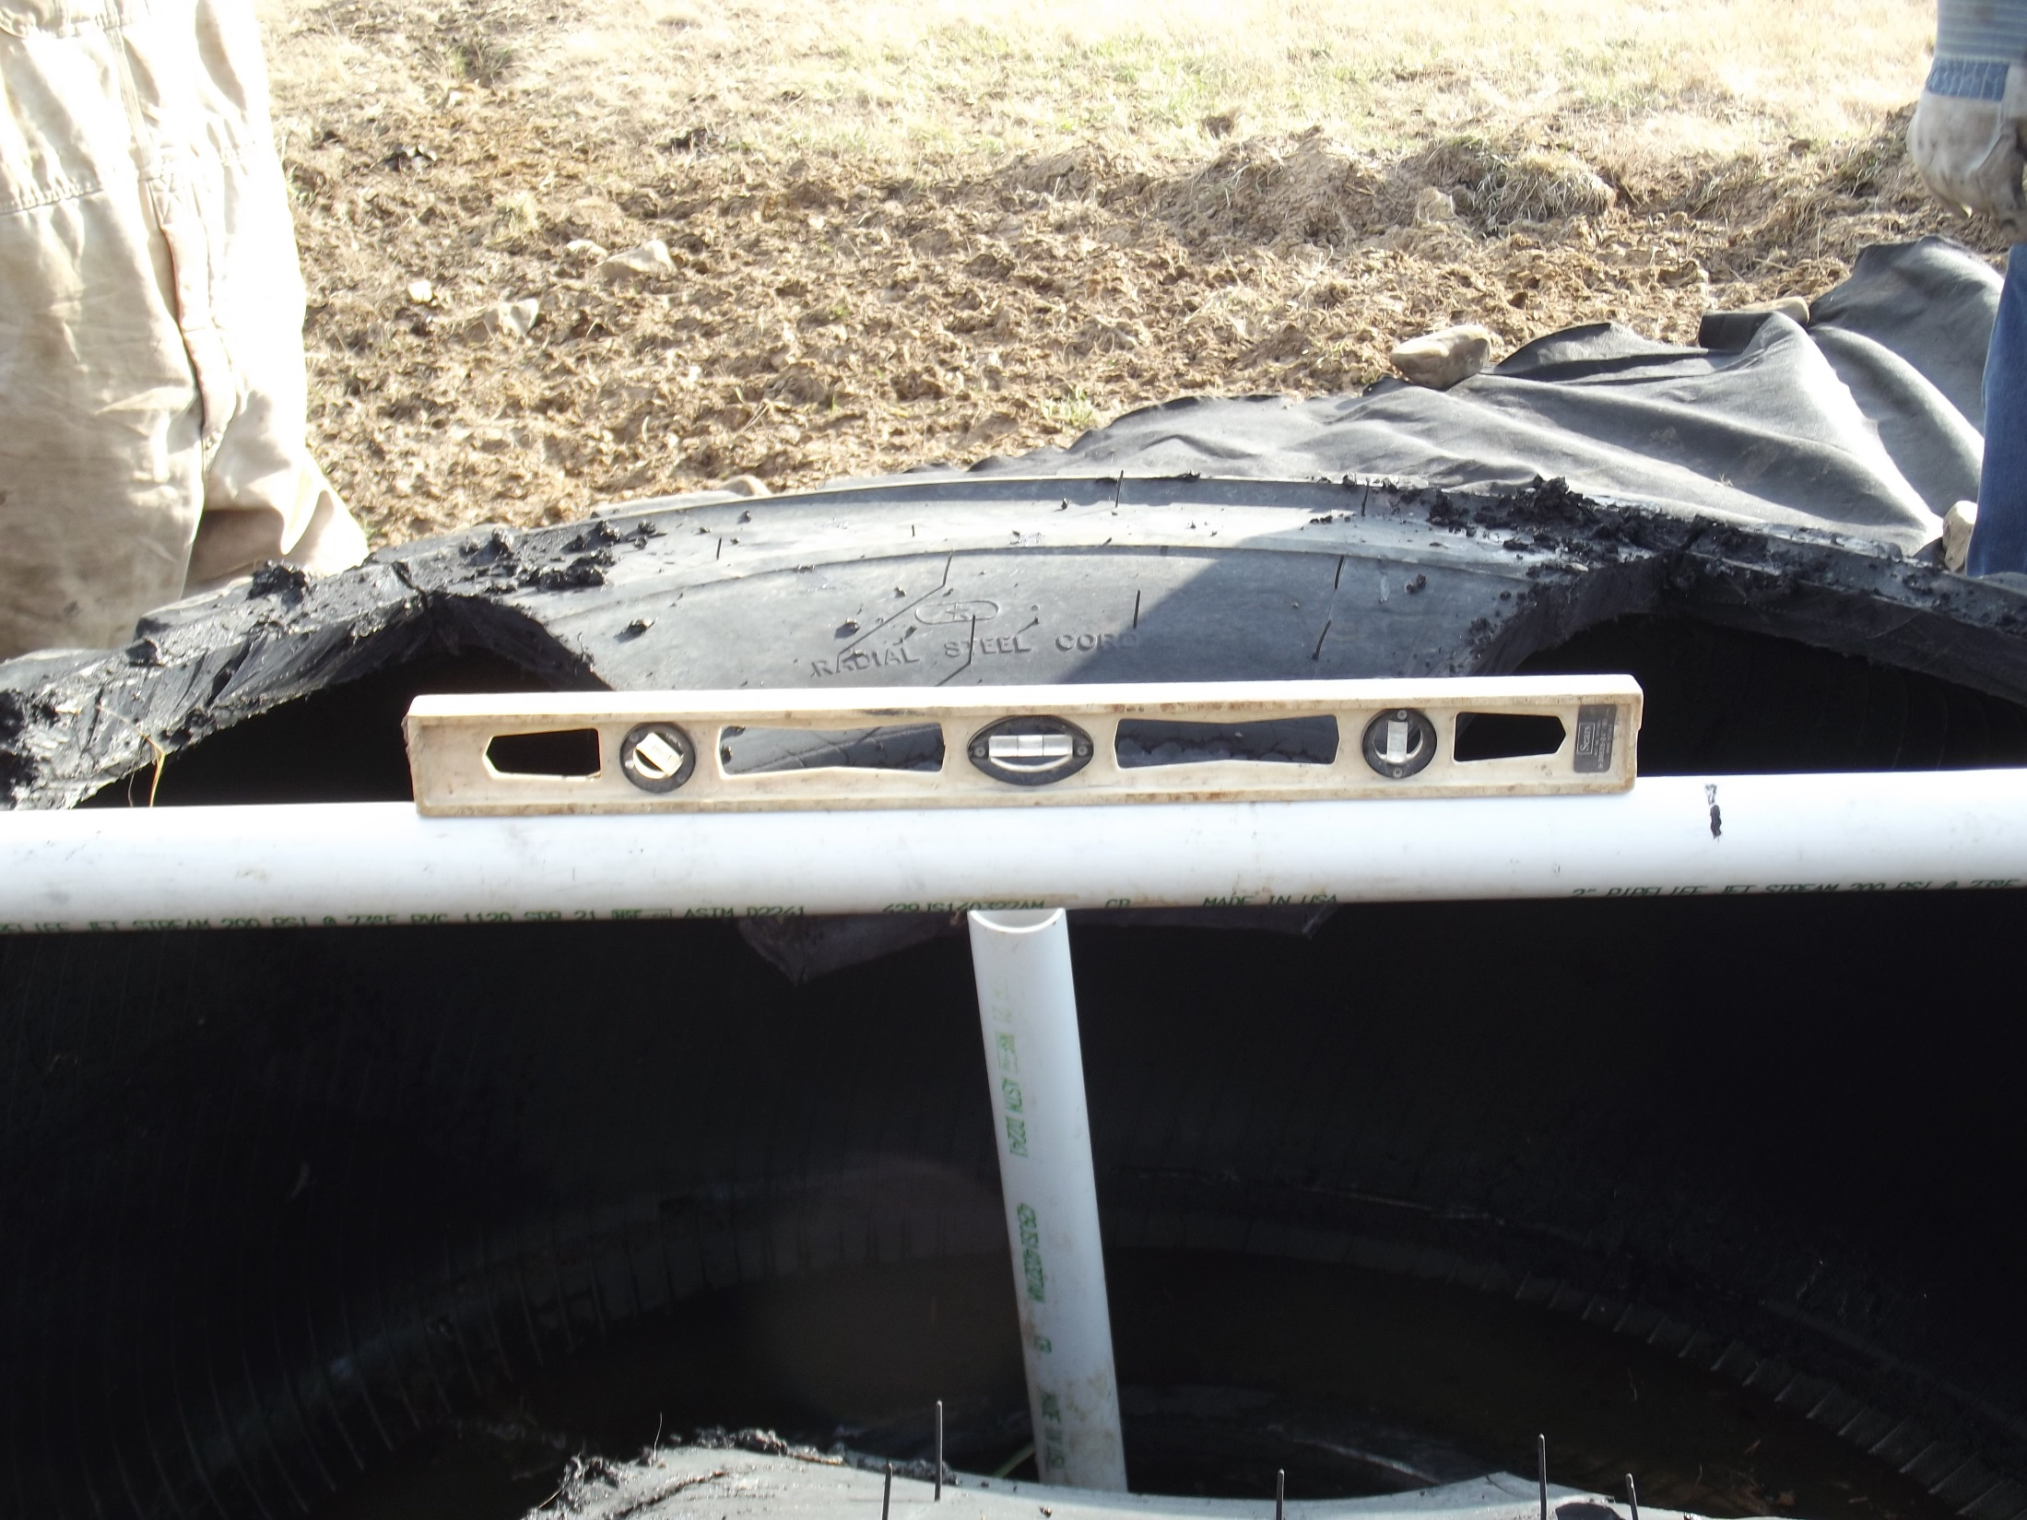
Level the tank before concreting the bottom.

Slide 11
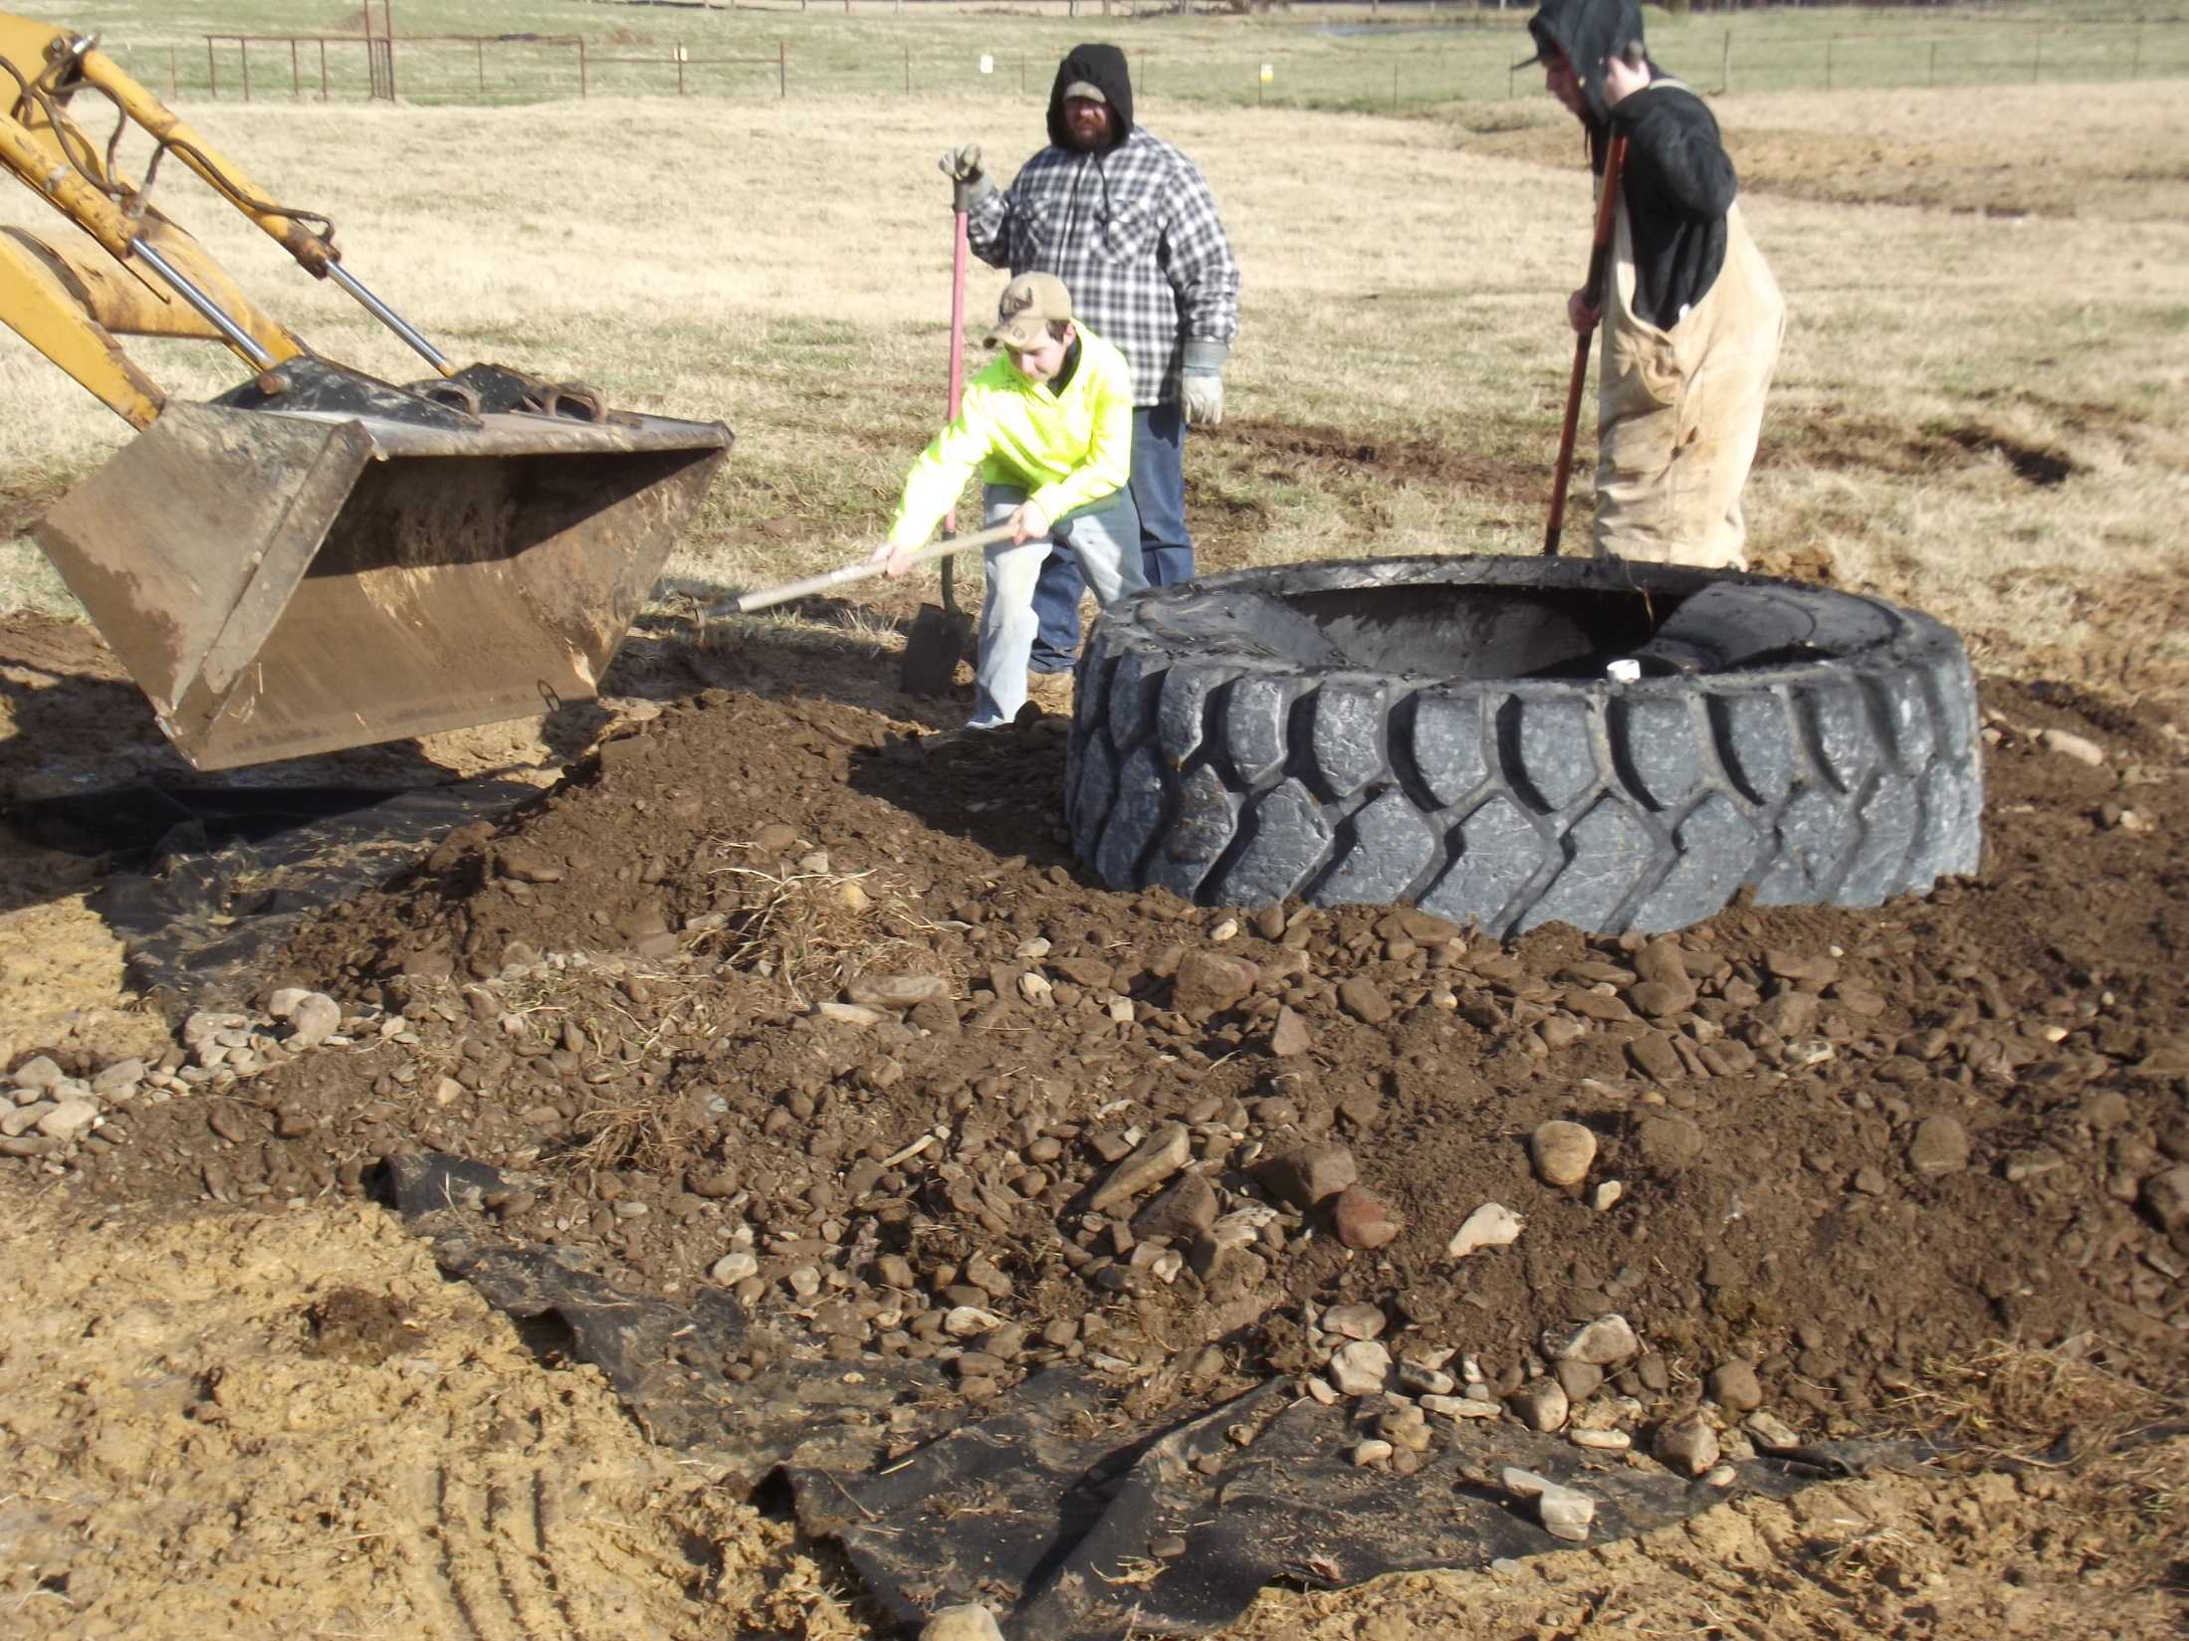
Place gravel and stone on the filter cloth around the leveled tank.
Large stones are best as they encourage cattle to leave the tank area.

Slide 12
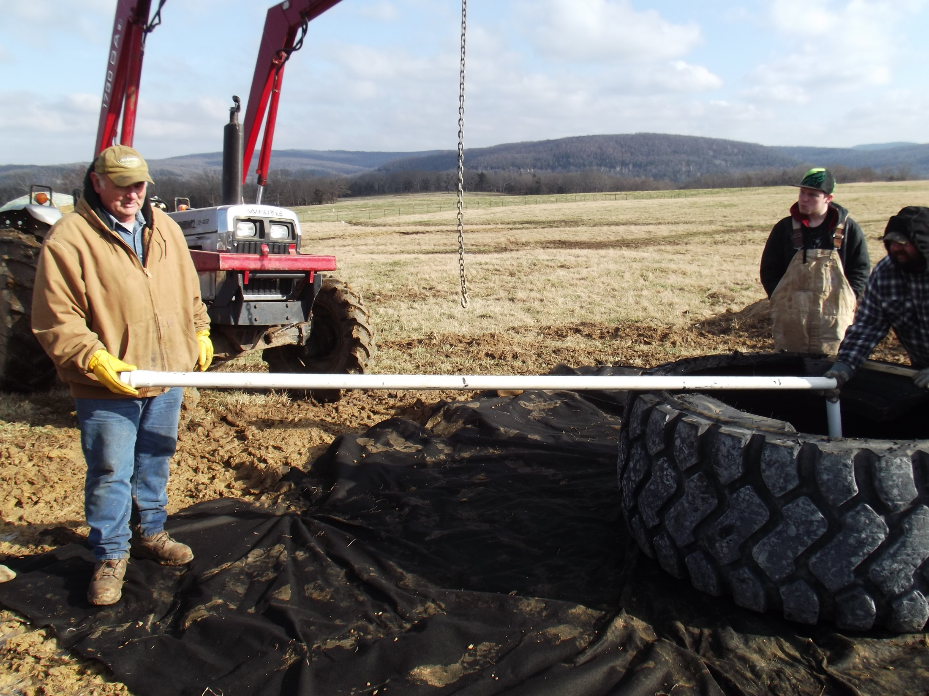
This pipe is used to measure the proper width of the filter fabric.

Slide 13
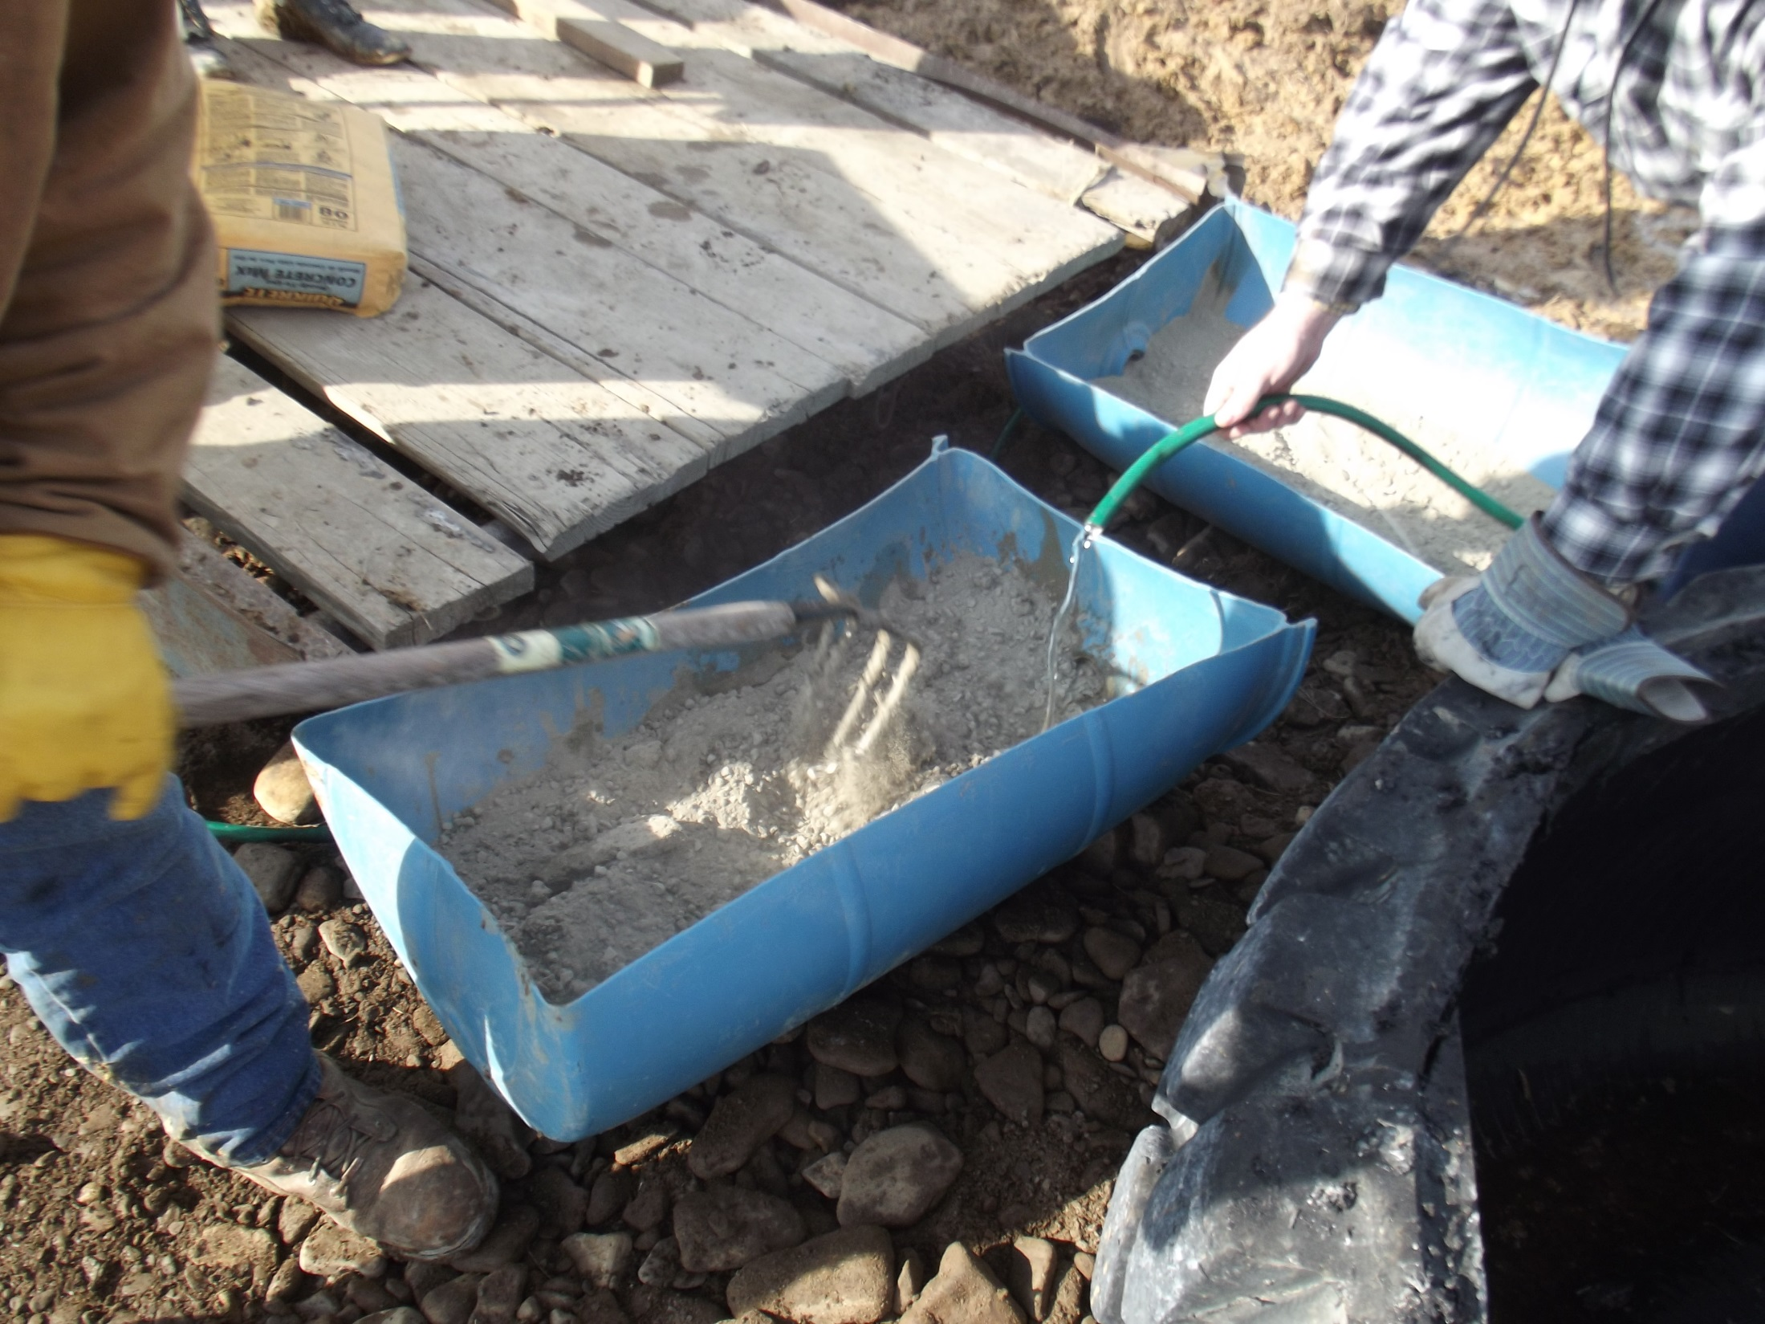
Mixing concrete to fill the tire bottom. We filled the entire bottom, but this is not necessary.

Slide 14
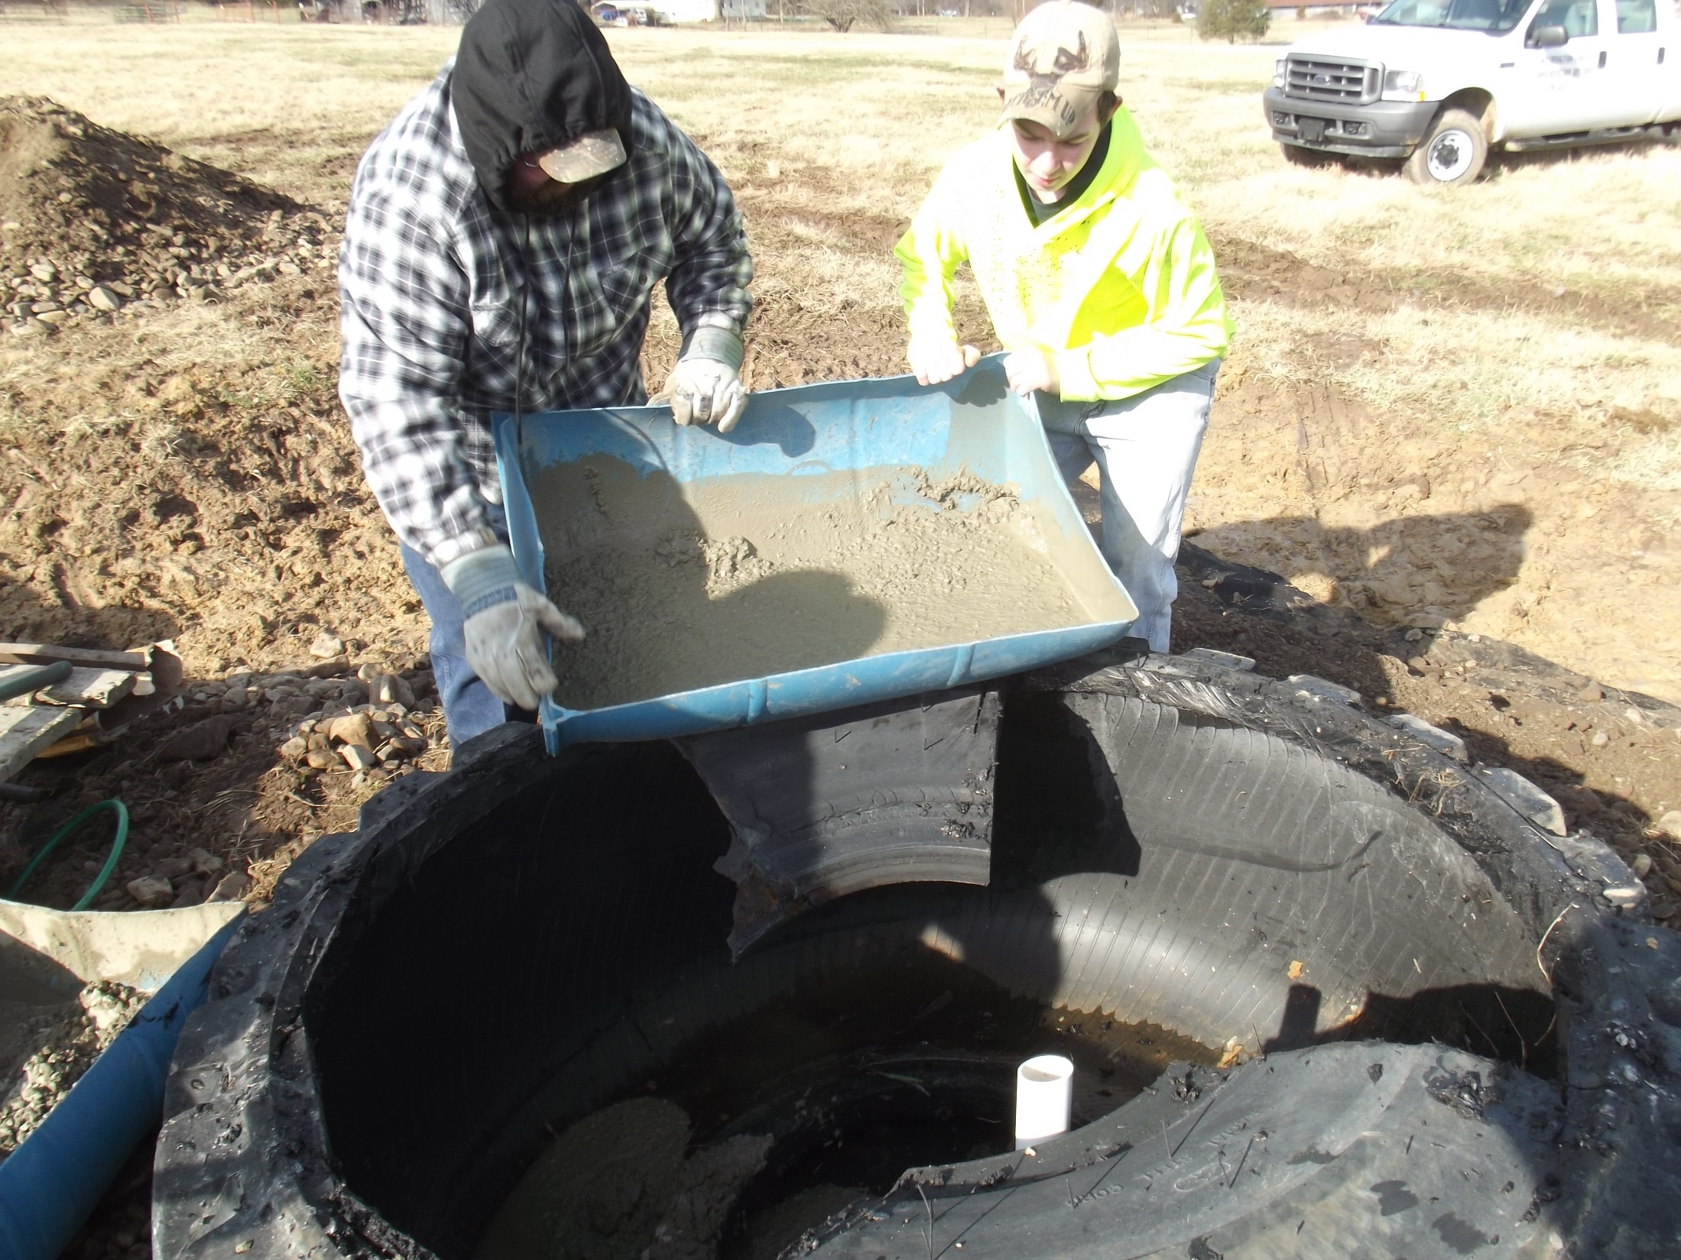
Leave the supply (and drain if present) pipe tall and protect from debris.

Slide 15
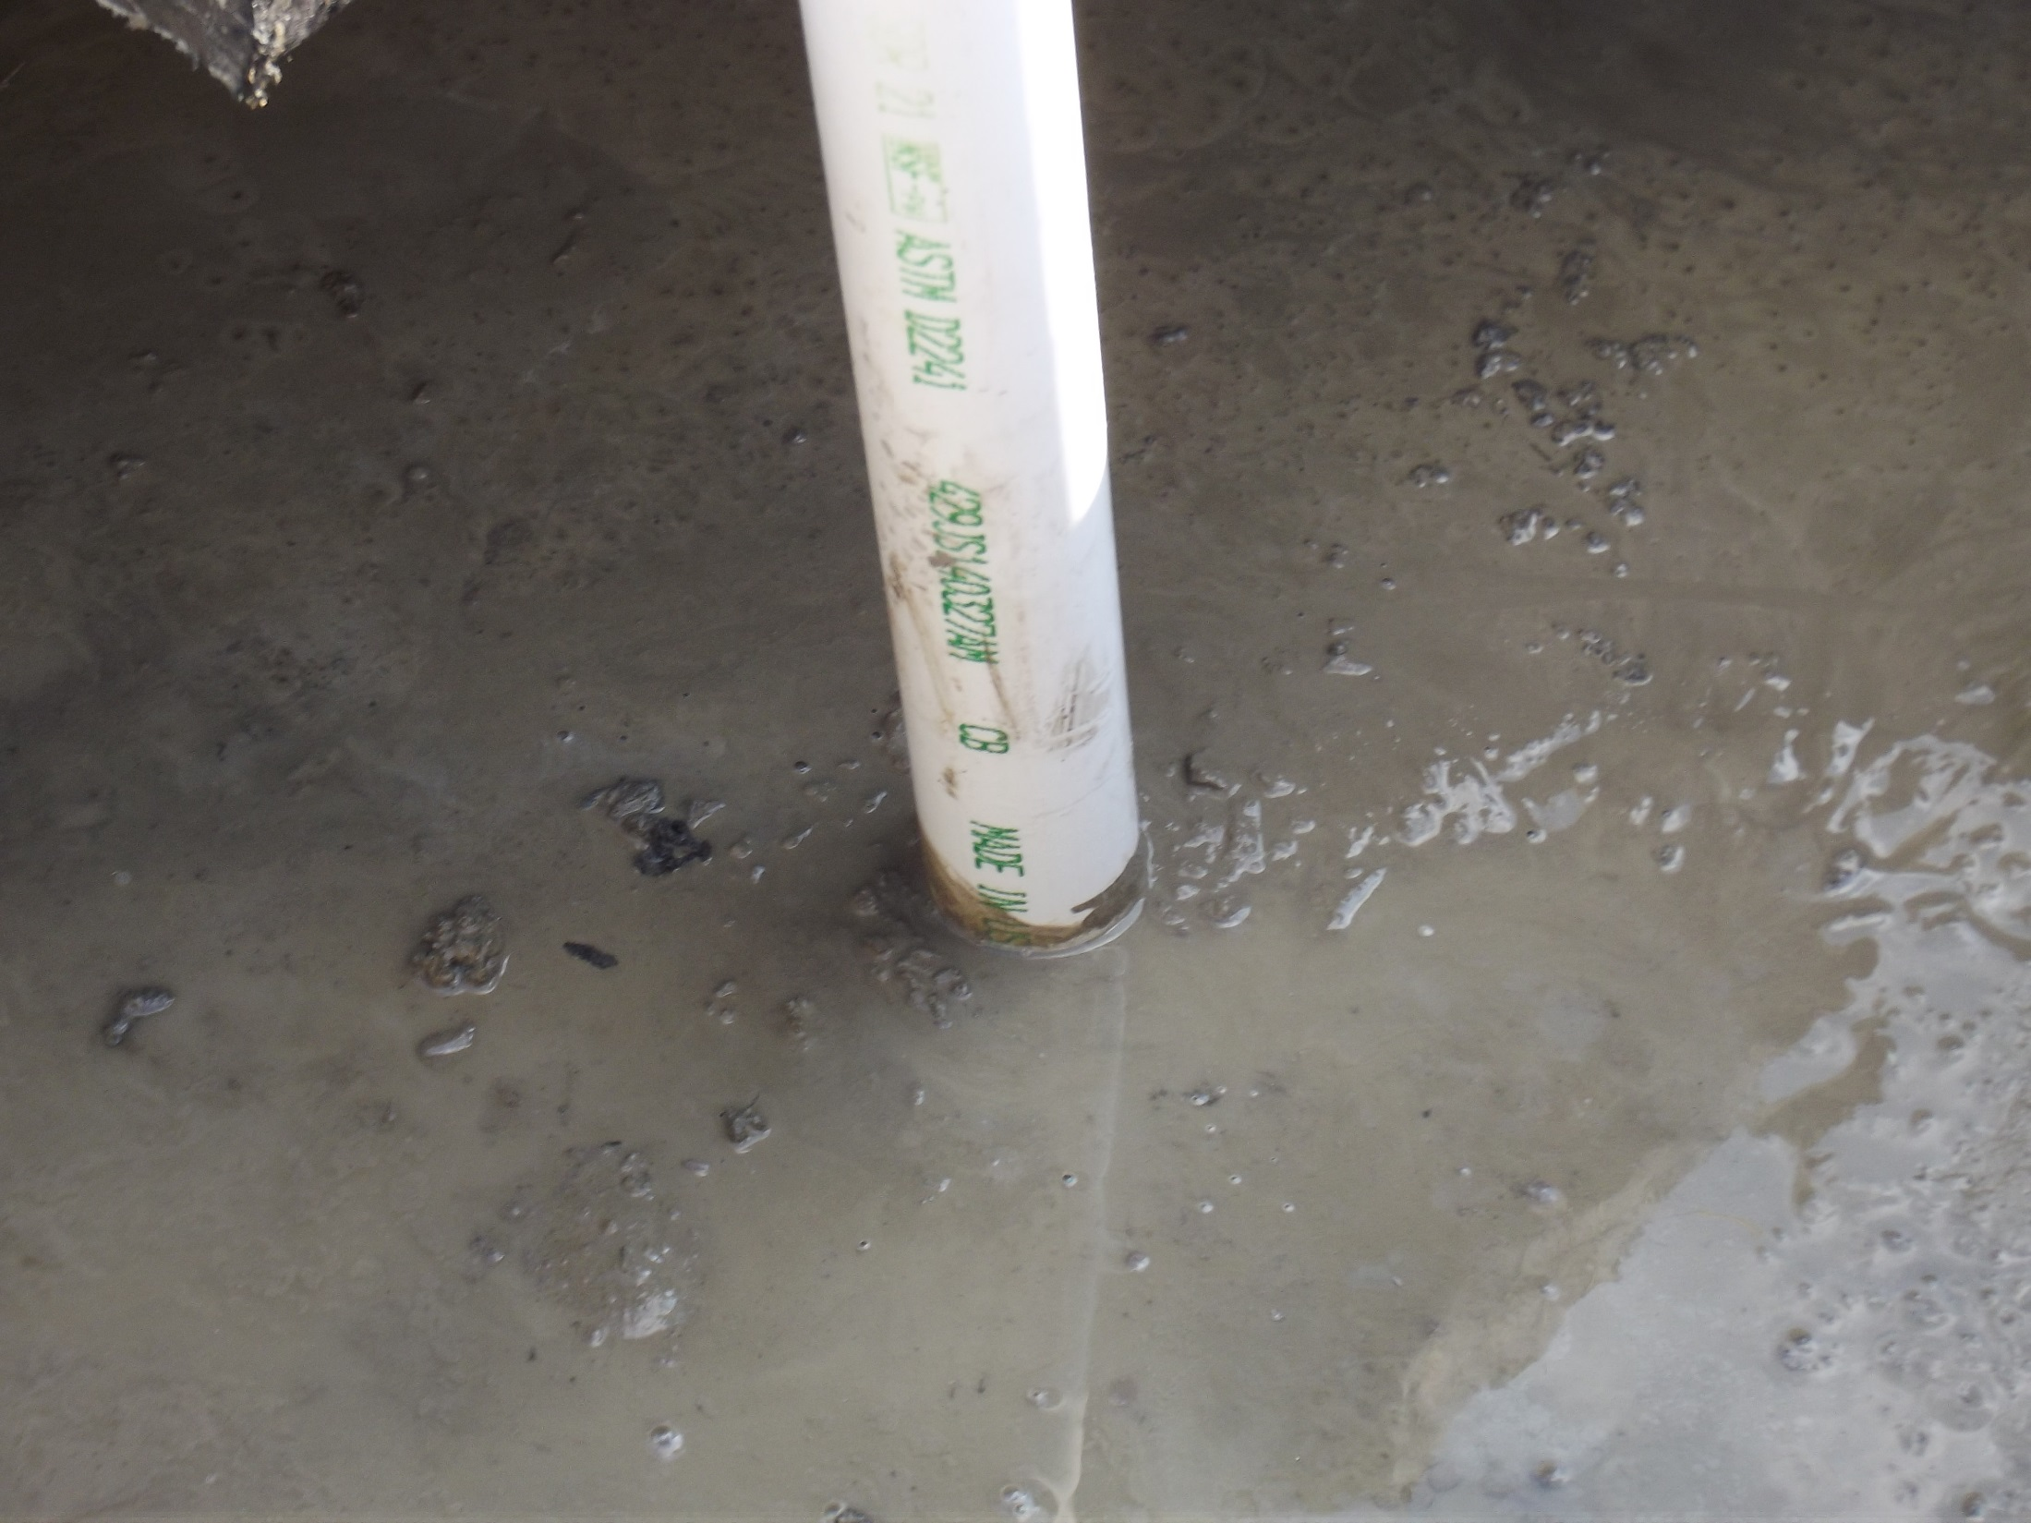
2 inch water supply pipe surrounded by concrete.
This pipe will be cut down later.

Slide 16
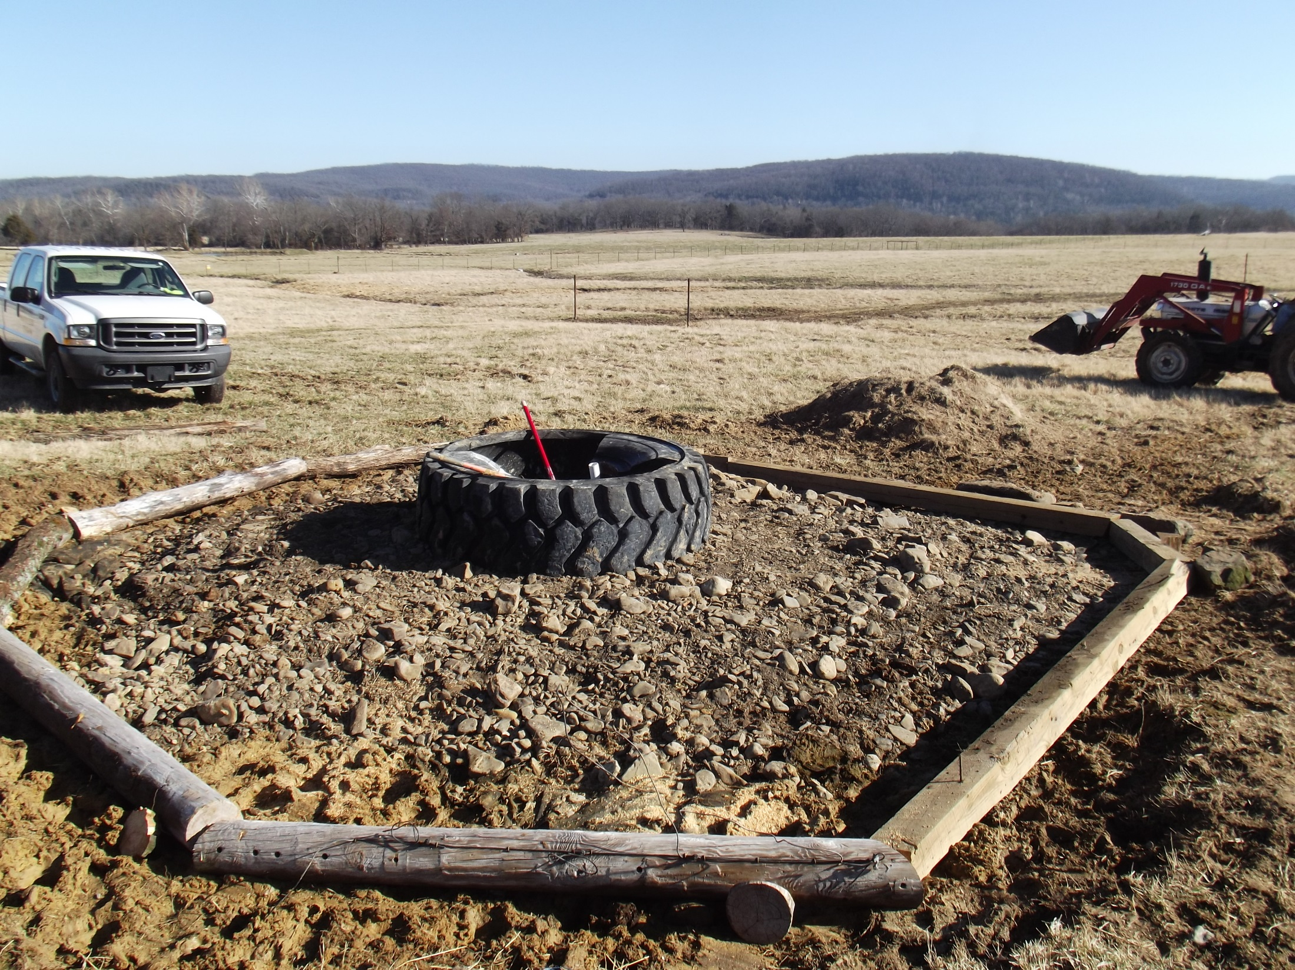
Preparing to back fill the heavy use area that is defined by 8 inch rot-proof, timbers.
Timbers are not required.

Slide 17
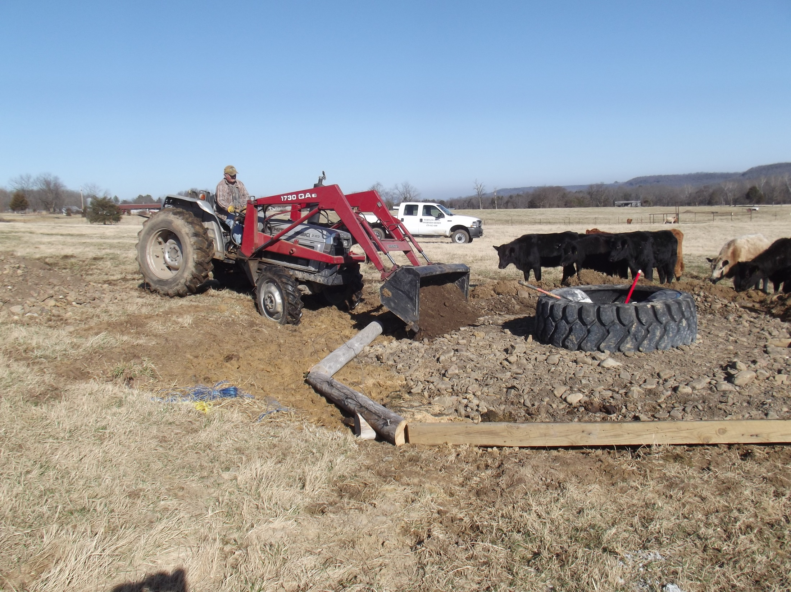
Here we are adding additional stone and gravel to extend the heavy use area.
The timbers help to create a consistent thickness.

Slide 18
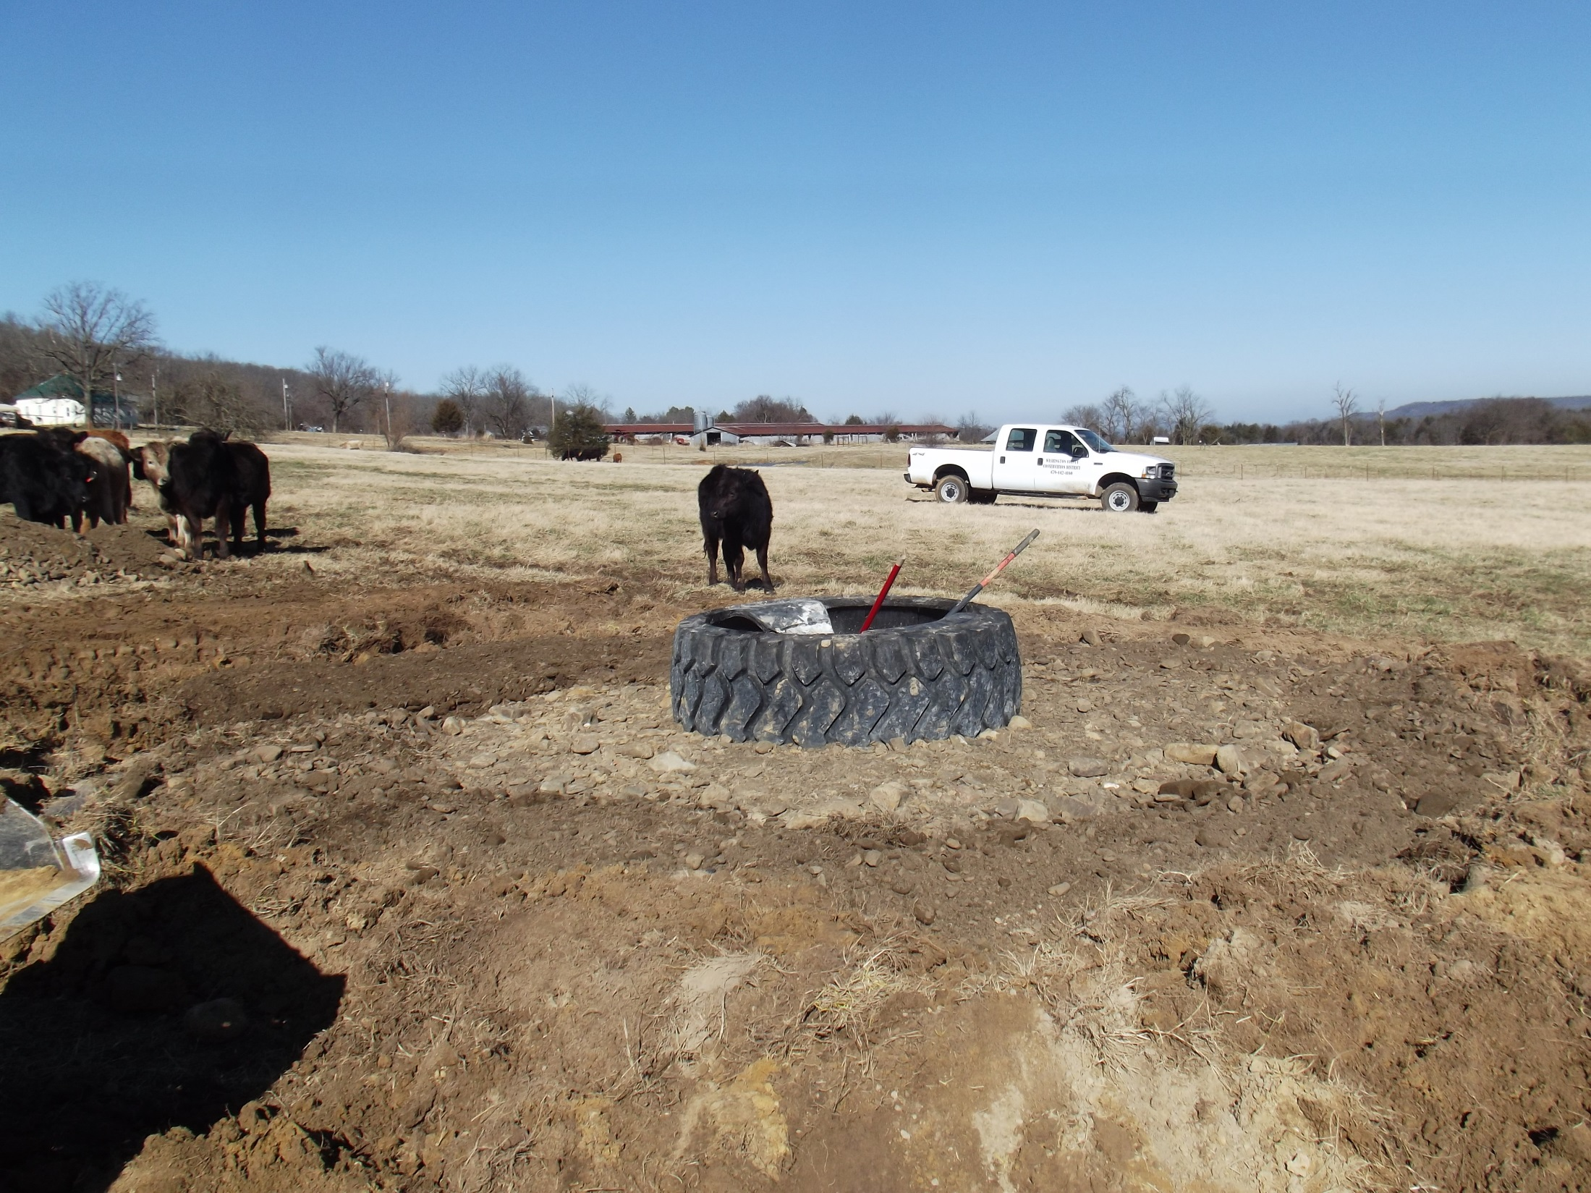
The finished heavy use area. Surrounding soil has been leveled around the enlarged heavy use area, and the timbers are buried.

Slide 19
NRCS APPROVED TANK INSTALLATION--Plumbing
These seven slides provided by NRCS
Note: you must check the current NRCS specification before constructing your tank

Slide 20
After the tire is placed. You may Install a riser over the inlet pipe. This allows for access to the inlet later. This pipe is concreted in place and a flex hose is attached to it later.

Slide 21
Flexible Supply Hose
6 inch riser and overflow concreted in. Attach flex hose to small inlet pipe at bottom of riser. Bring flex hose to valve inserted on the cap.

Slide 23
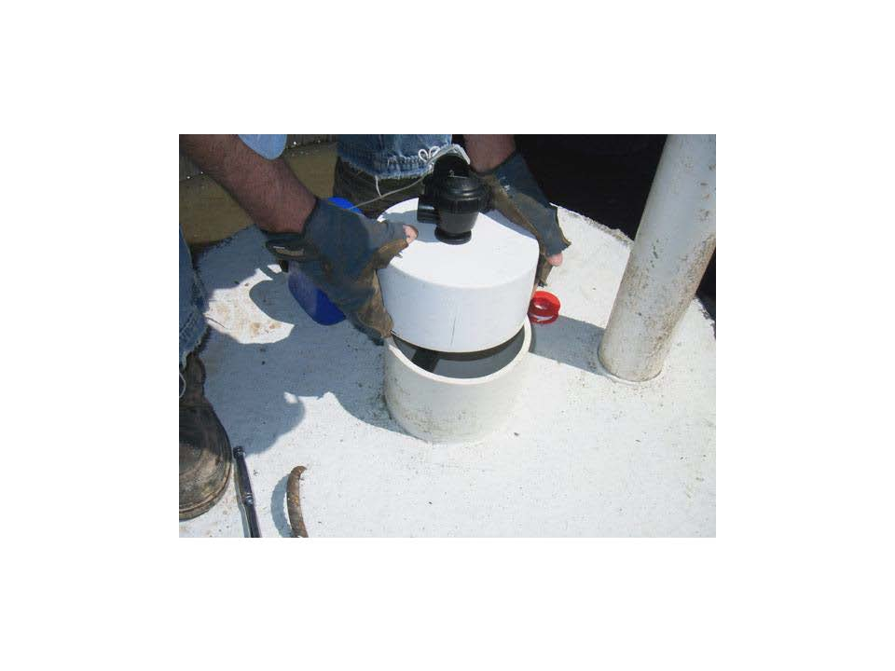
The flex hose is attached to the valve that is screwed into the top of the slip on cap. DO NOT GLUE this cap as you will need to service the supply line some day.

Slide 24
Overflow pipe
Float

Slide 25
The entire tank will fill to the level of the float string. You will adjust the length of the float to completely fill the tank.

Slide 26
Two Types of Tanks that are NOT NRCS-Approved
Tractor Tire and Concrete Culvert
These are cheap, easy to install and effective

Slide 27
Stacked Tractor Tires
Tractor Tires are usually not approved by NRCS for Cost-Share.
Tractor tires are typically narrow compared to very large truck tires. This results in small water volumes.
These tractor tires are stacked, caulked and bolted together.
It is possible that cattle will dislodge and upturn a smaller tank especially if it is very low or empty.
Plumbing is finished in the usual way.
We recommend placing these tanks on a good heavy use area to avoid erosion around the tank.
Erosion will lead to tank tipping and failures

Slide 28
Backfilled pipe trench
Preparing the tank pad. Note: Two inch PVC supply line stub out is visible in front of tractor.

Slide 29
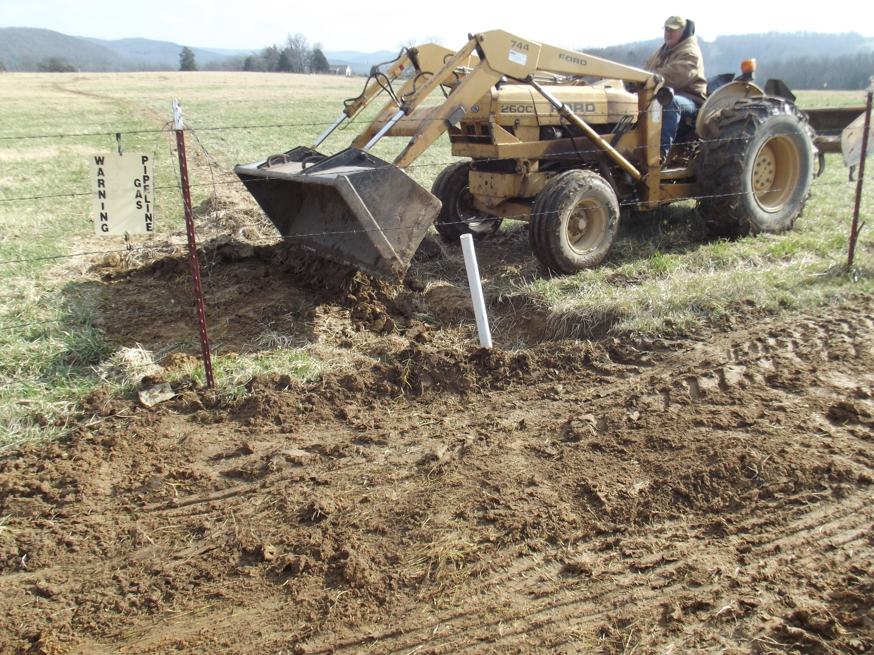
Level the site. Note the stub out is crooked, but this does not affect the plumbing.

Slide 30
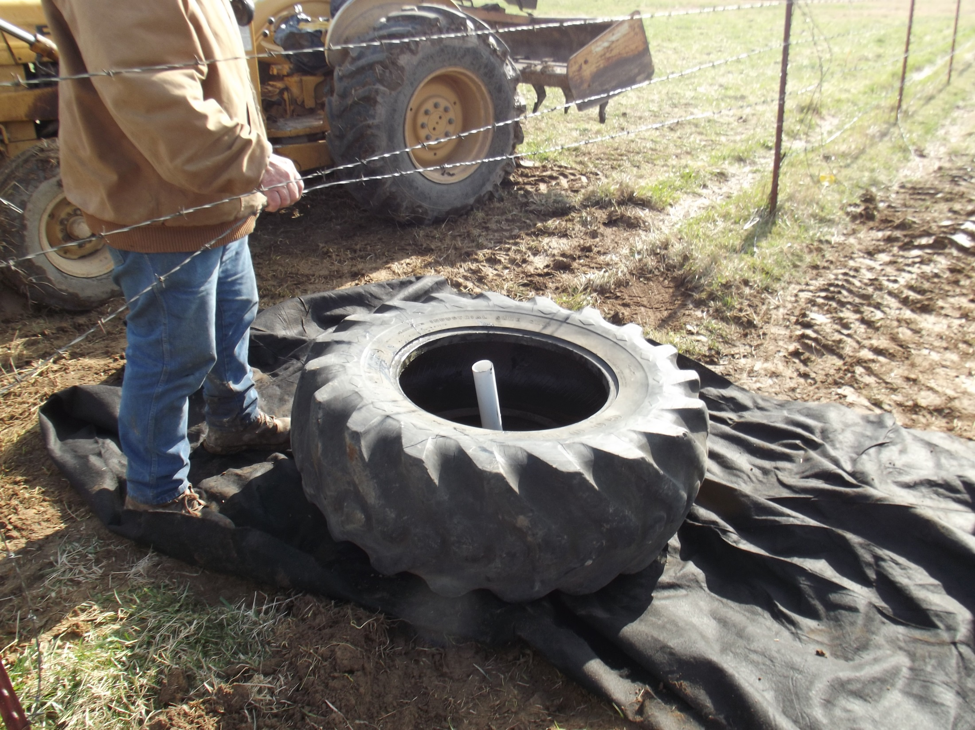
The first of two tires is placed above the filter cloth. We will follow the same basic procedures in building a heavy use area and completing the plumbing. Note: the bottom tire is whole and uncut.

Slide 31
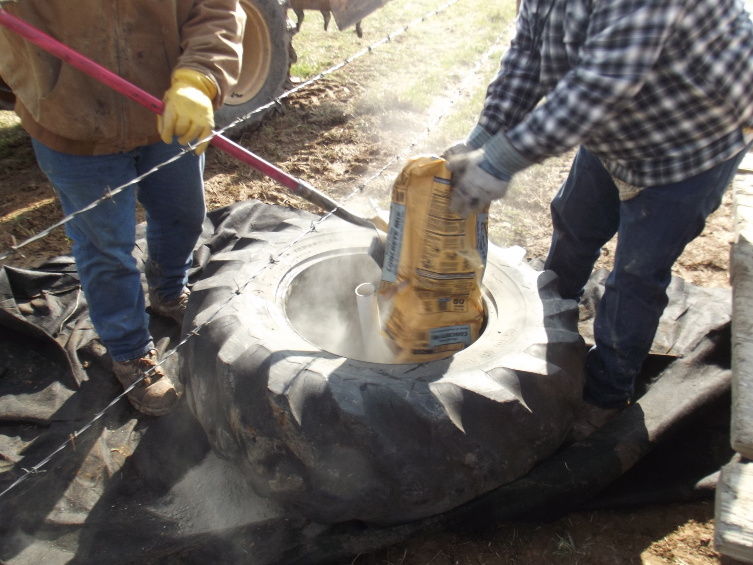
Instead of mixing the concrete and pouring in, we are covering the bottom with dry concrete (quikrete). Later we will add water until the dry mix is saturated.
(again, this is not approved by USDA for cost shared tanks!)

Slide 32
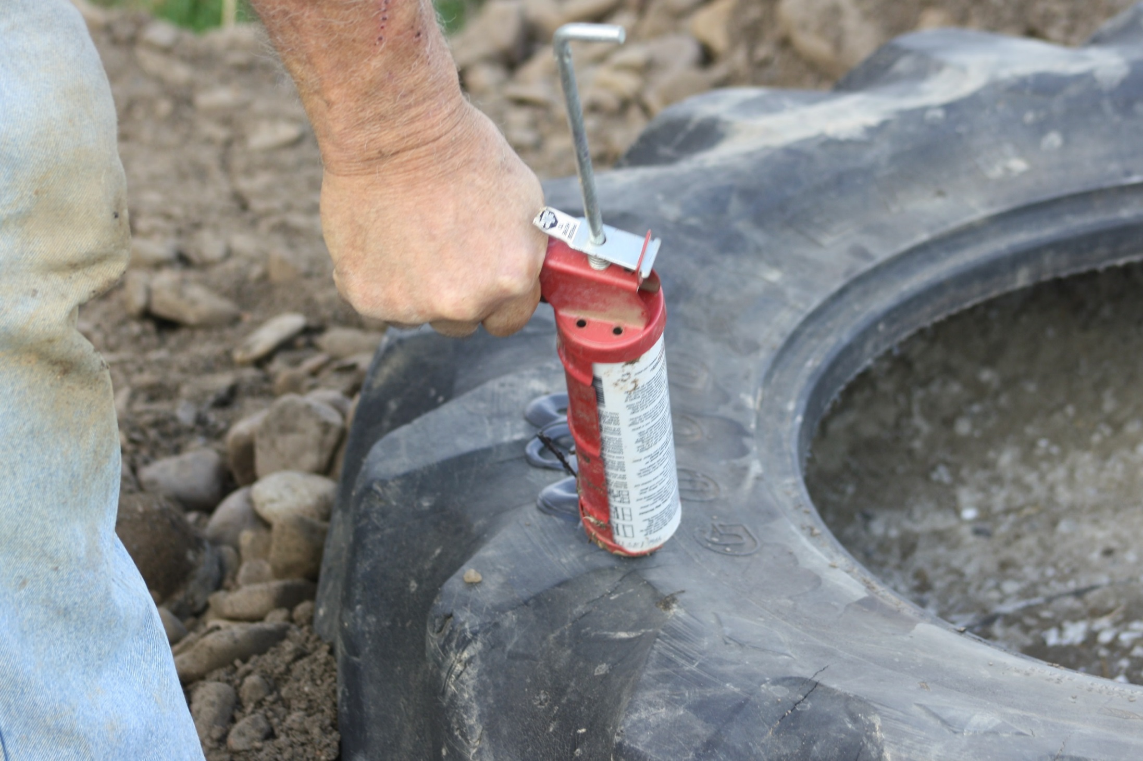
After the tank’s concrete is set, apply a adhesive sealant that is rated for continuous submersion.

Slide 33
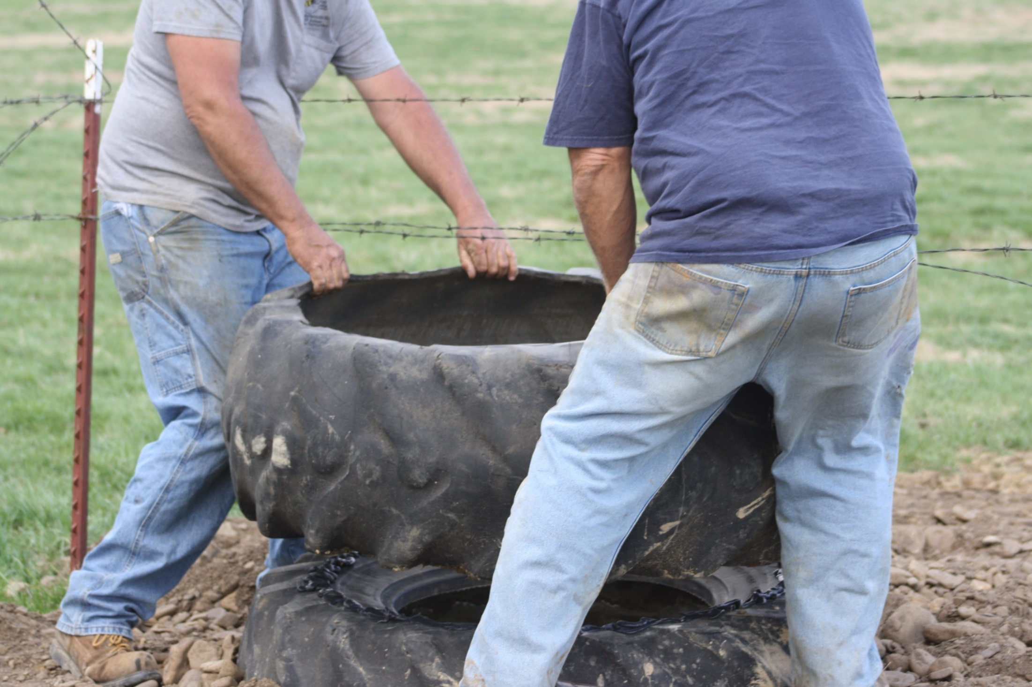
Place the second tire on top of the first. Note: the top sidewall of the top tire has been removed.

Slide 34
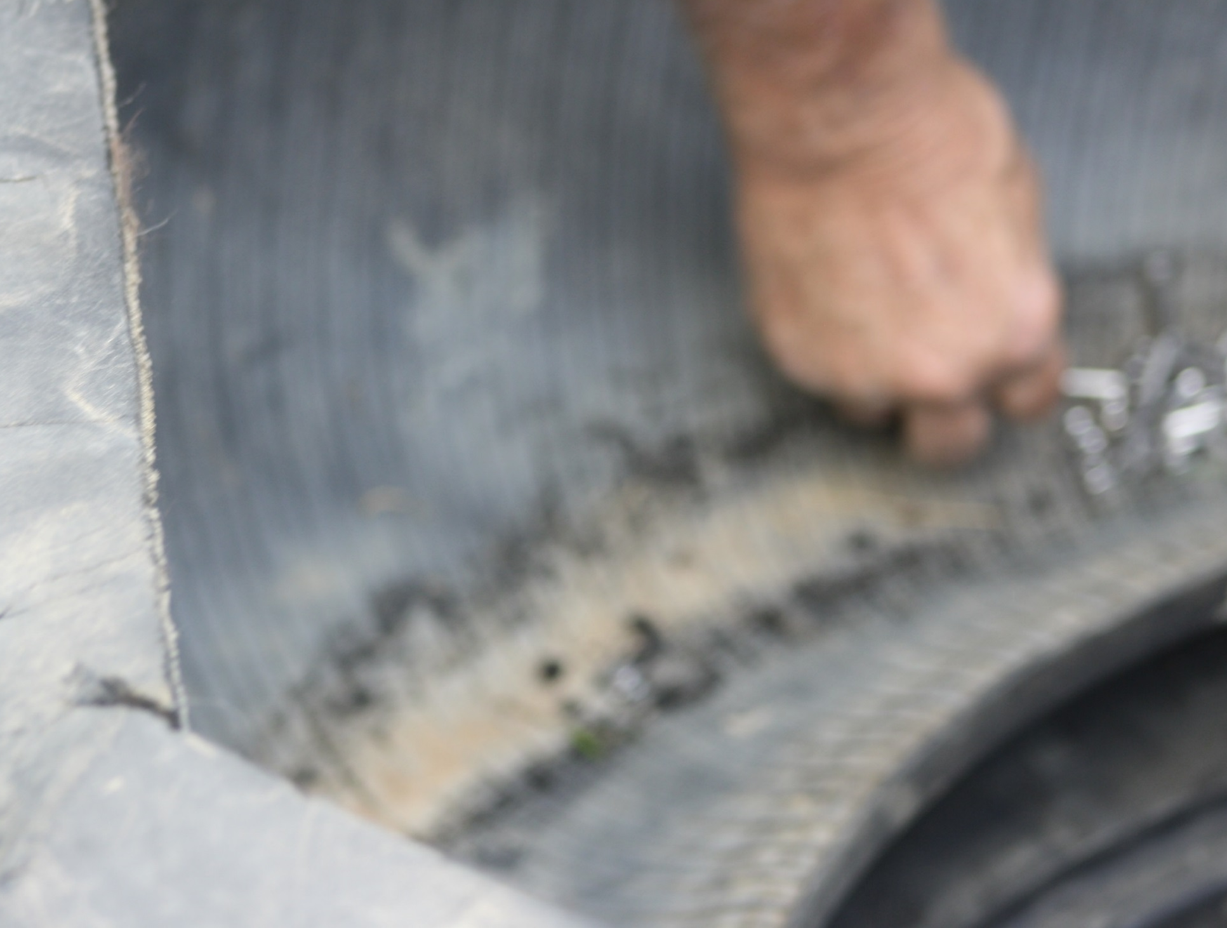
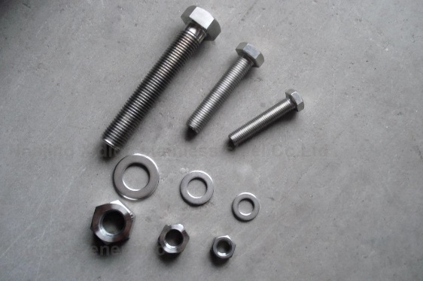
Bolt the two tires together using stainless steel fasteners

Slide 35
Concrete tank made from culvert Not NRCS Approved

Slide 36
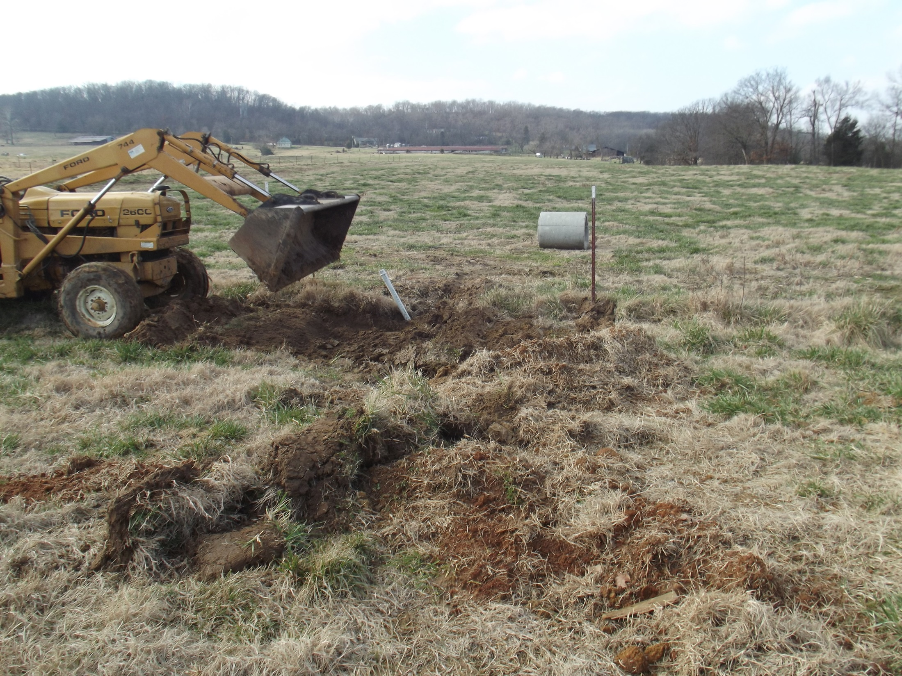
Preparing the site. Note: service pipe is very crooked, but this is of little importance.

Slide 37
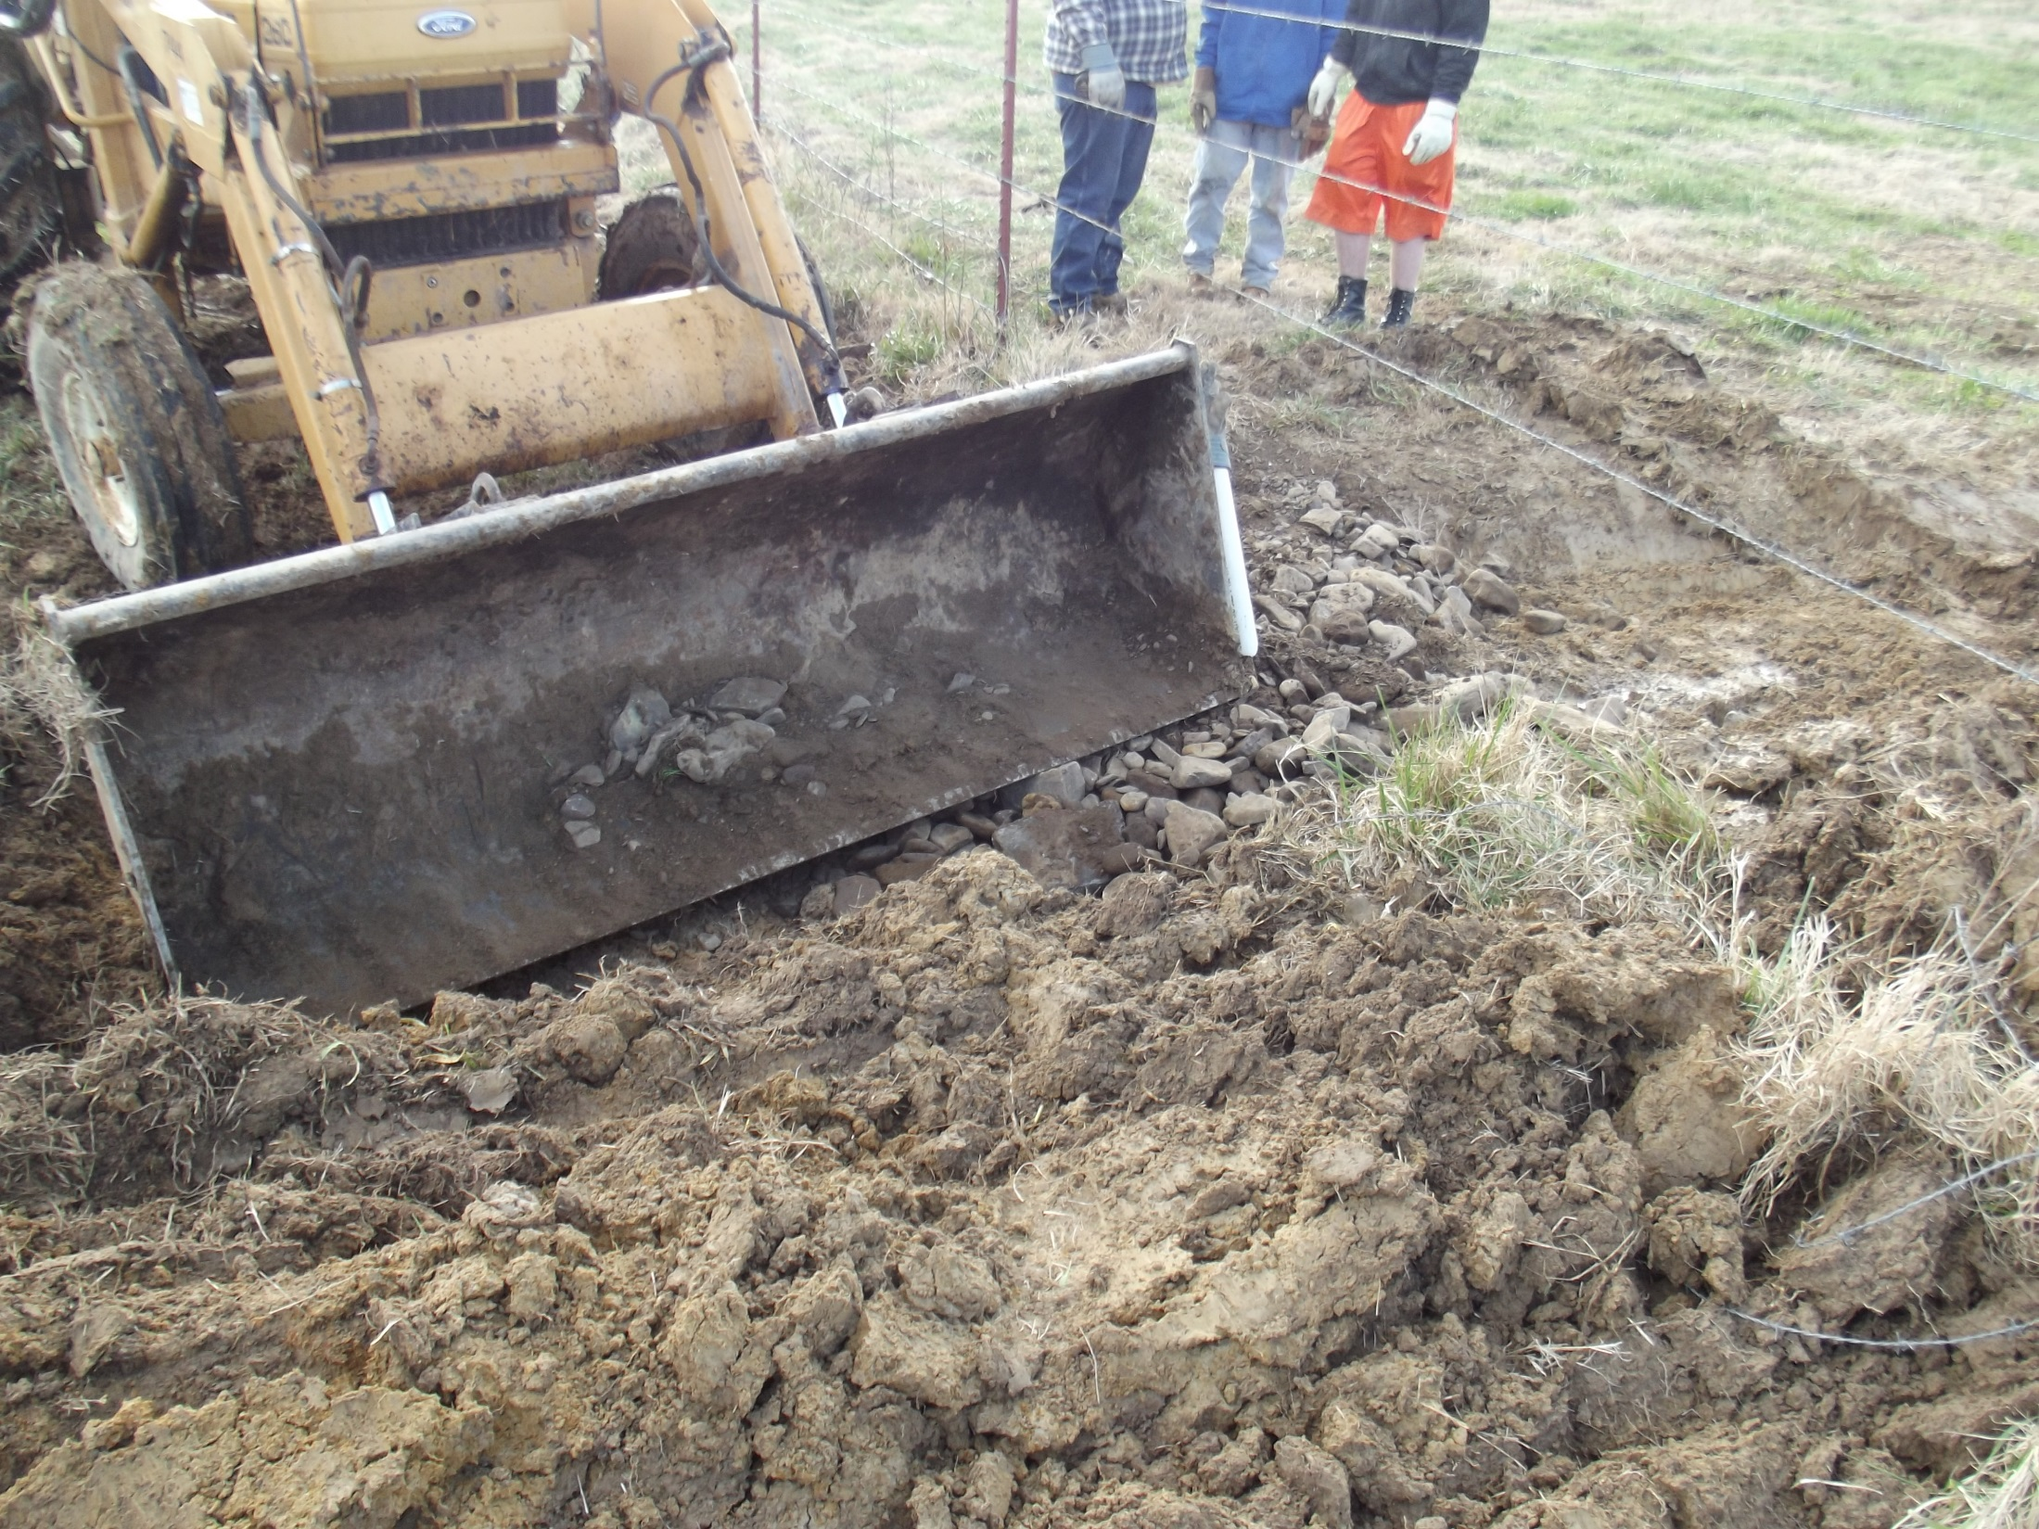

Slide 38
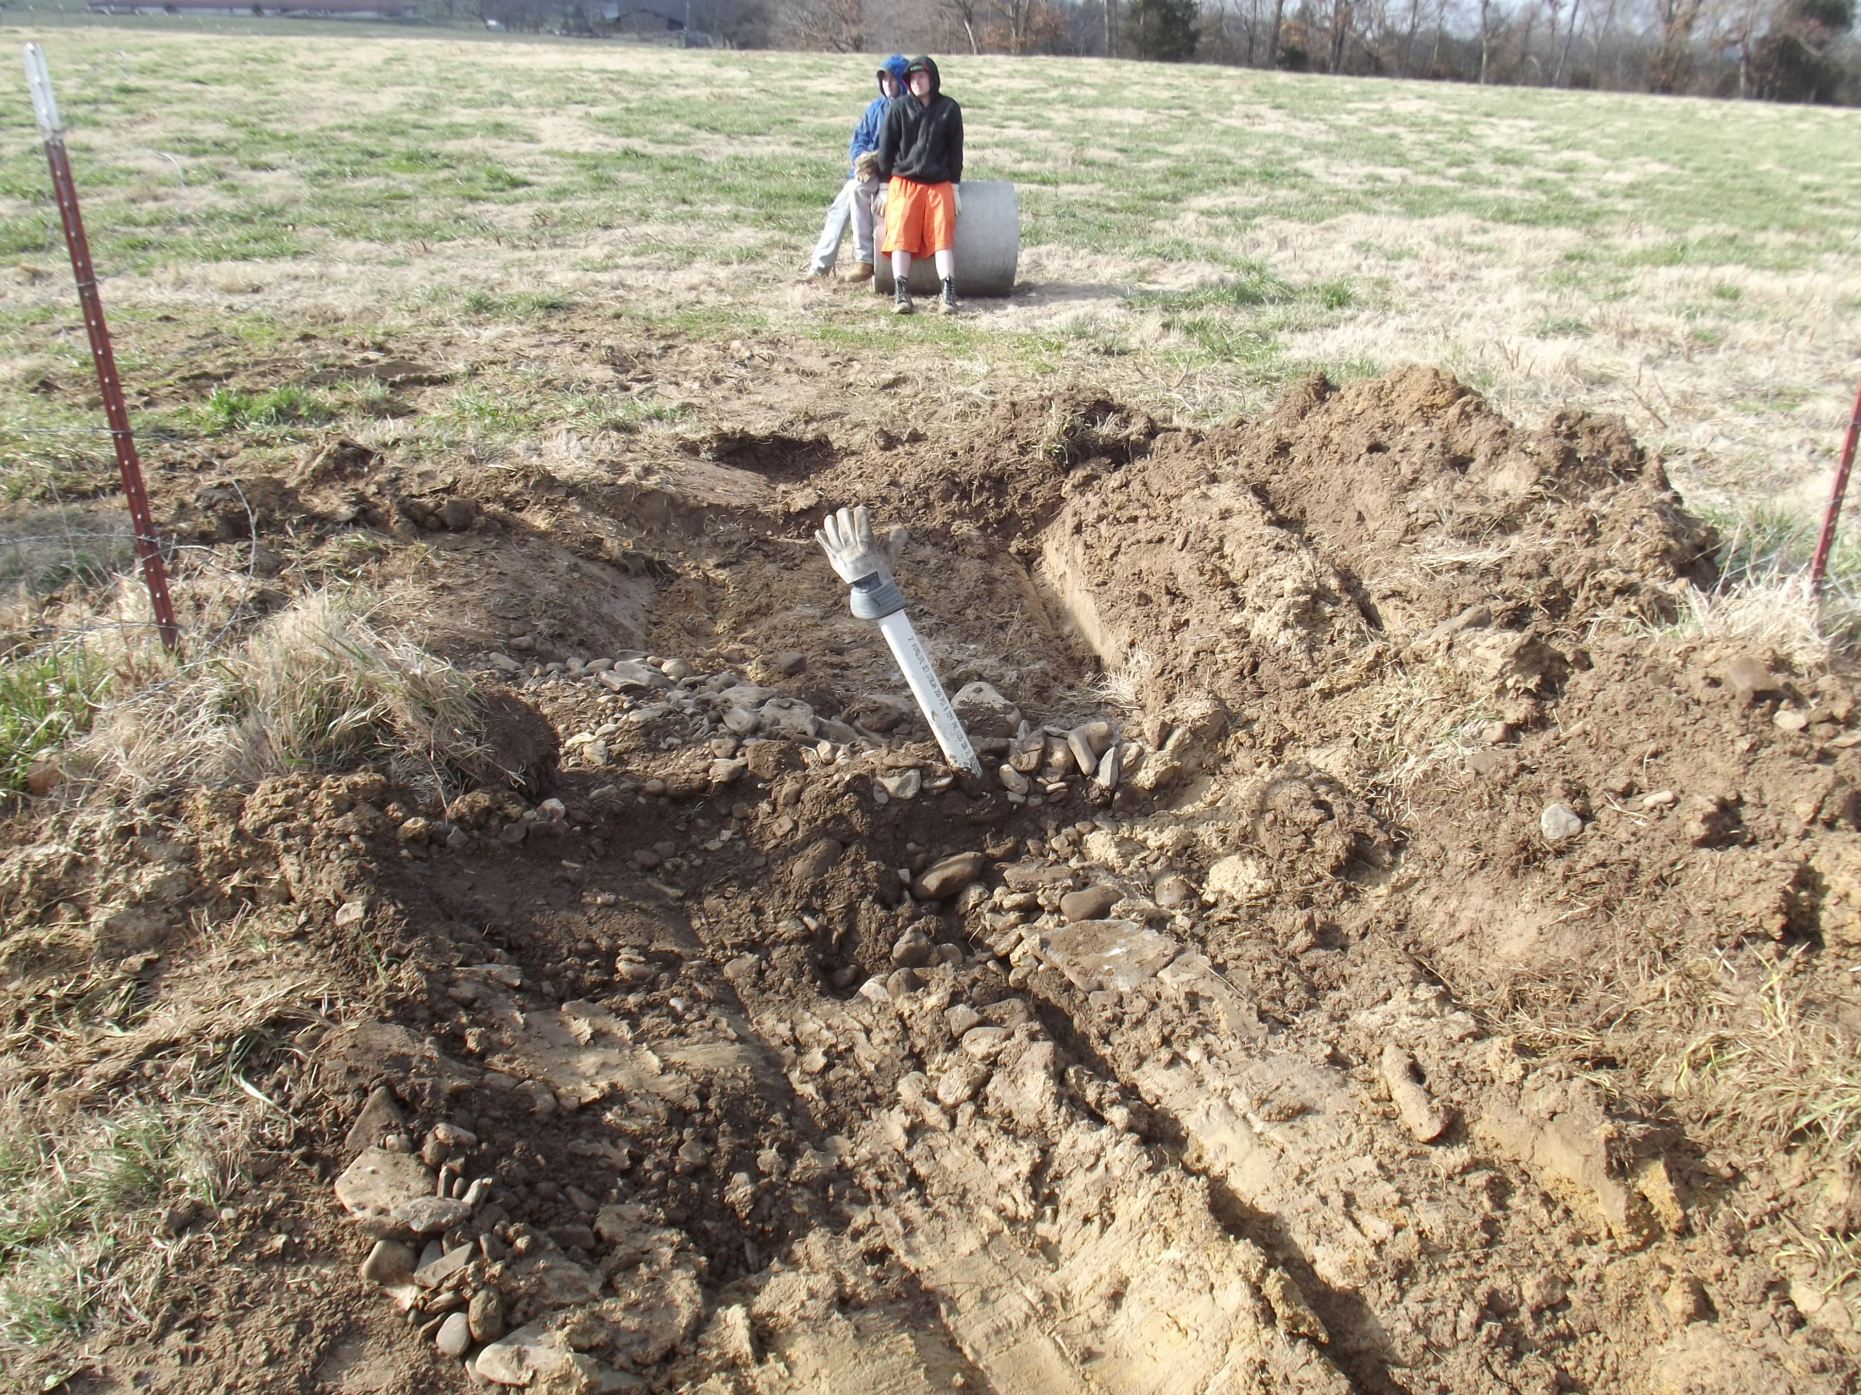
Covering the open supply line to prevent trash from entering the system.

Slide 39
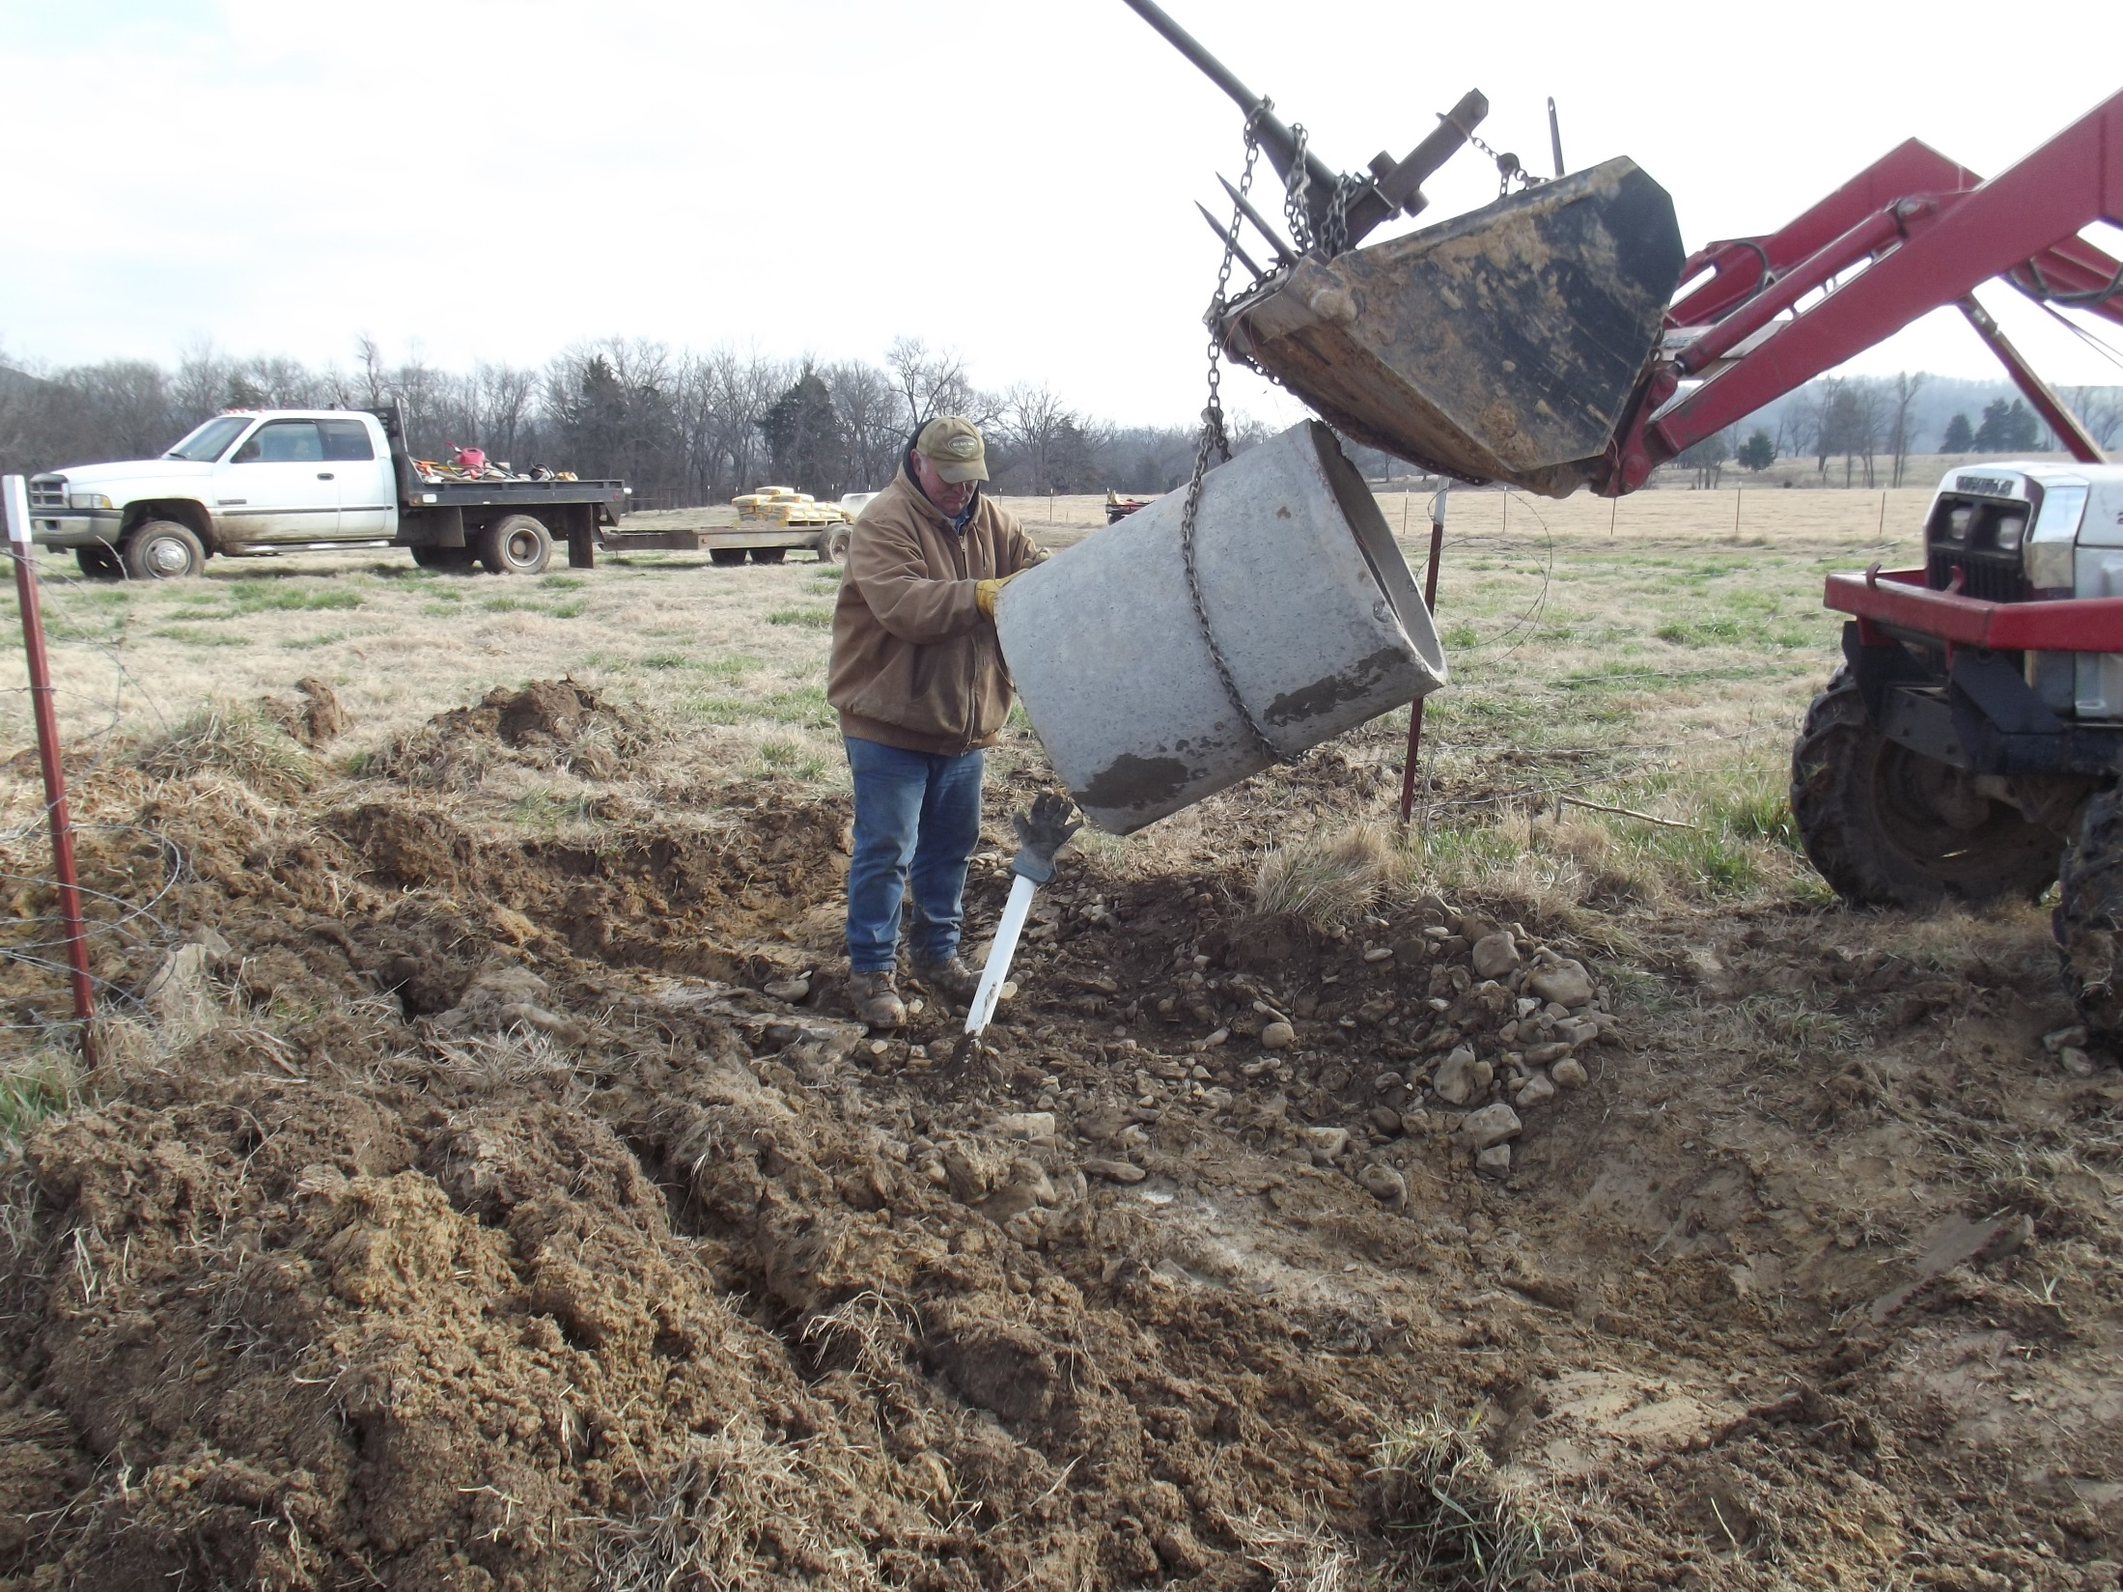
Place the culvert piece over the pipe as usual.

Slide 40
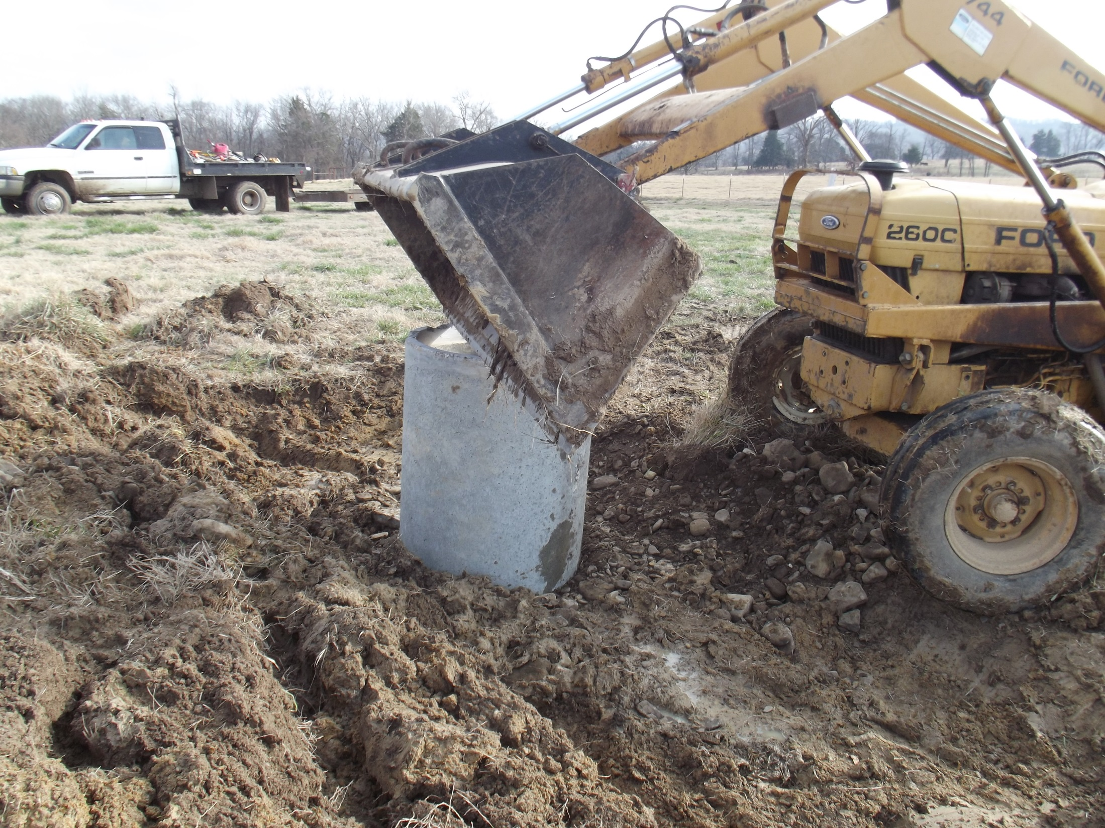
Press culvert down and level with the tractor bucket.

Slide 41
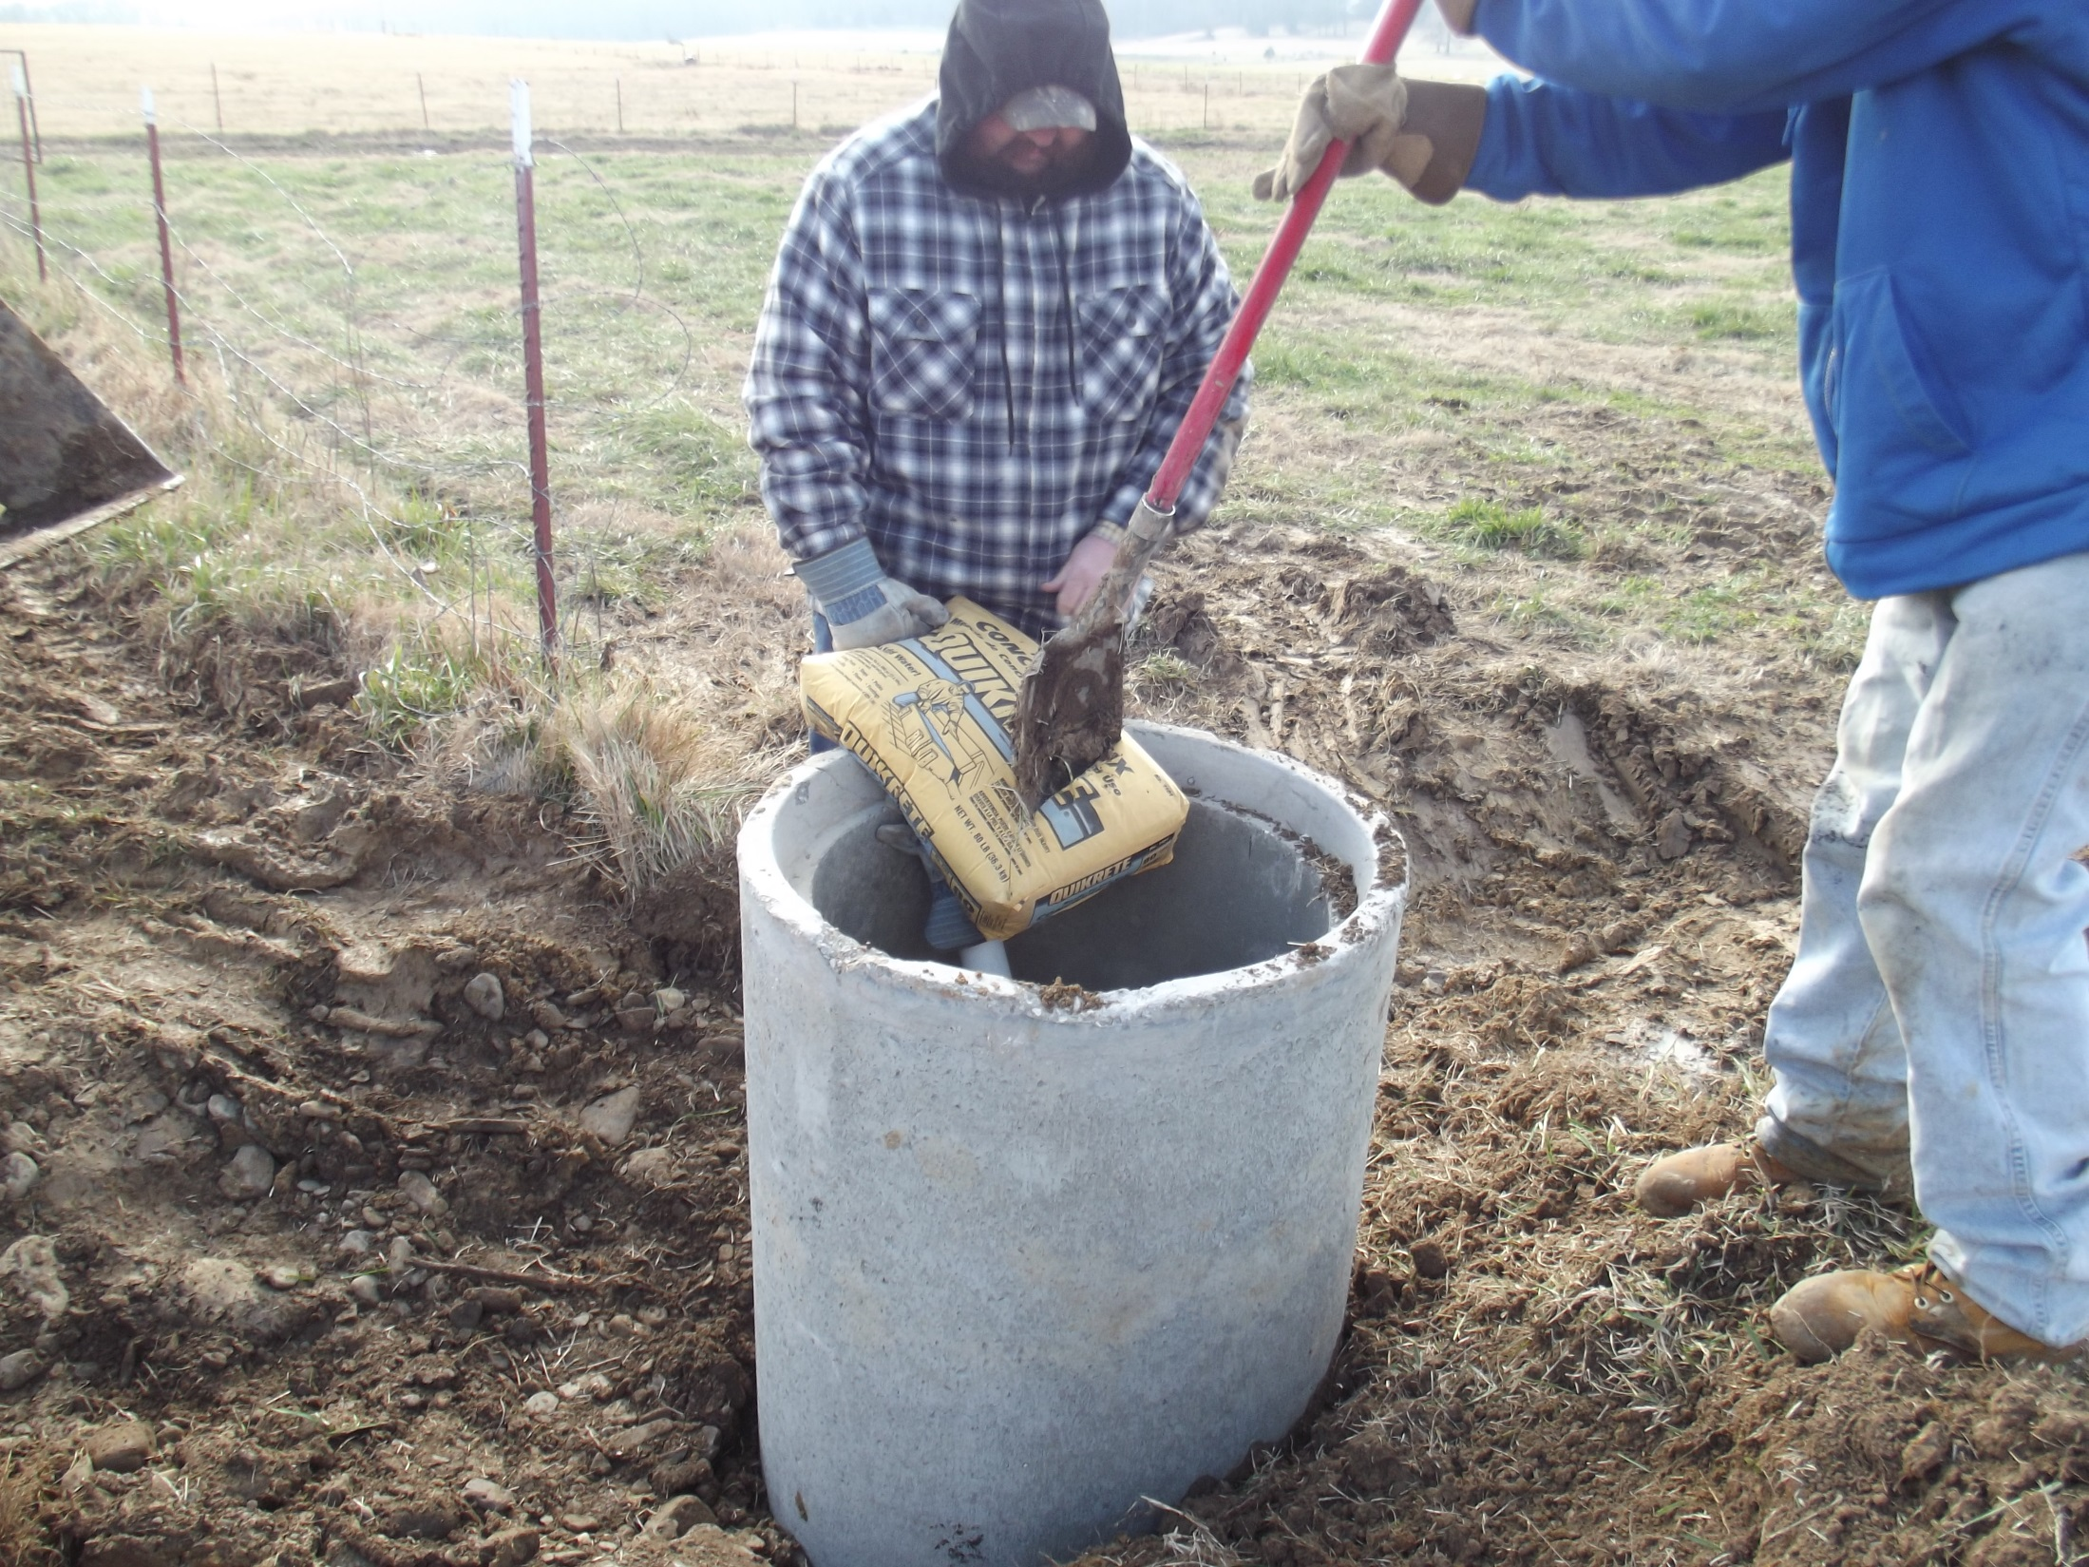
Dry fill and wet the quikrete to seal the bottom. We will add a Heavy Use Area with filter Fabric and stones later.

Slide 42
Plumbing a Tank on Shumate Farm

Slide 43
The supply pipe should be cut down to a few inches above the concrete bottom. We will install a cap to the supply line that will have a valve connection. The valve acts similarly to a toilet tank valve as it is submerged and operated by a float mechanism.

Slide 44
Cap
Supply Line. Cut down and prepped for gluing on a cap.

Slide 45
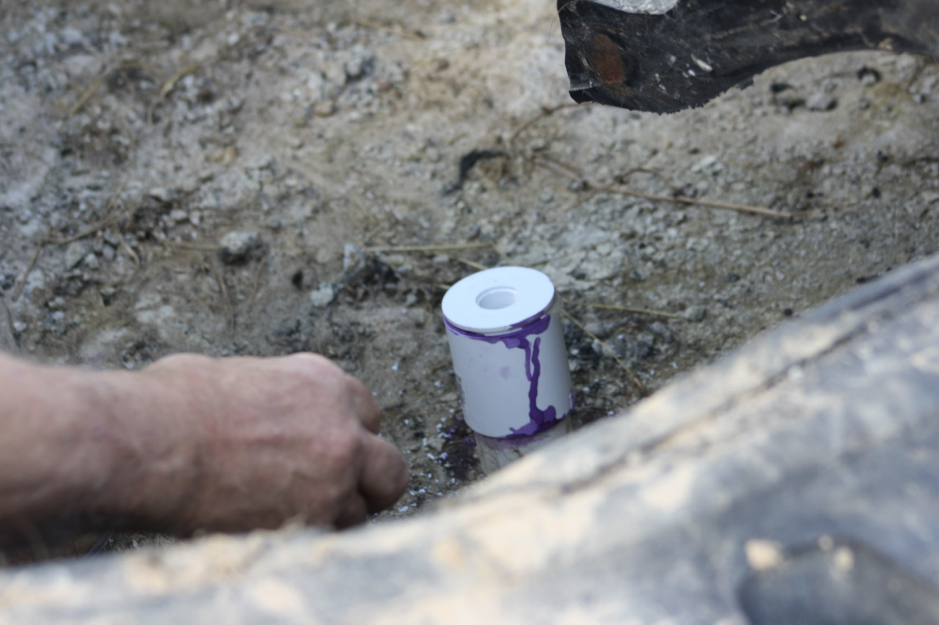
Cap is made from a coupler with a ¾ inch fitting. Note: this differs from the small service line in the NRCS slideshow which has a flexible hose attachment inside a 6 inch pipe riser (see below). This method does away with the riser; however, it will result in destruction of the service pipe in the event the tank is ever removed. This is not a big problem since PVC is easily repaired.

Slide 46
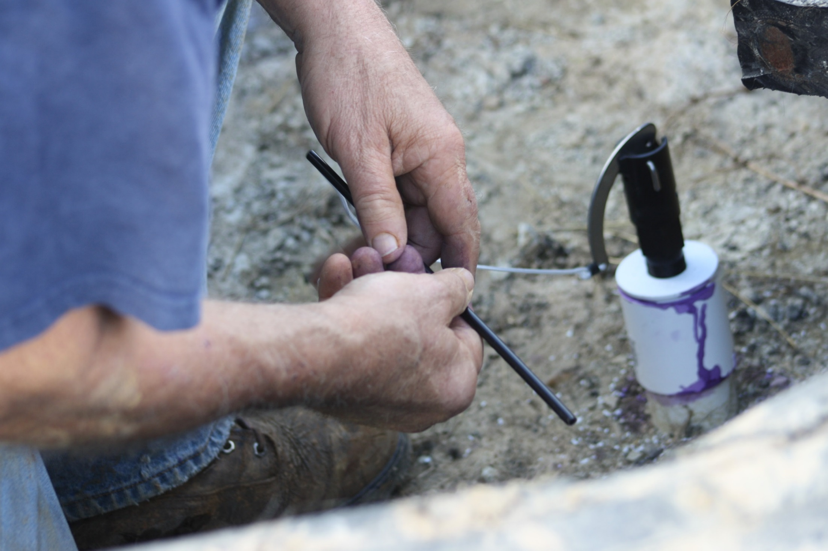
Control valve screwed into the ¾ inch cap hole. We see here the cable attachment for the float.

Slide 47
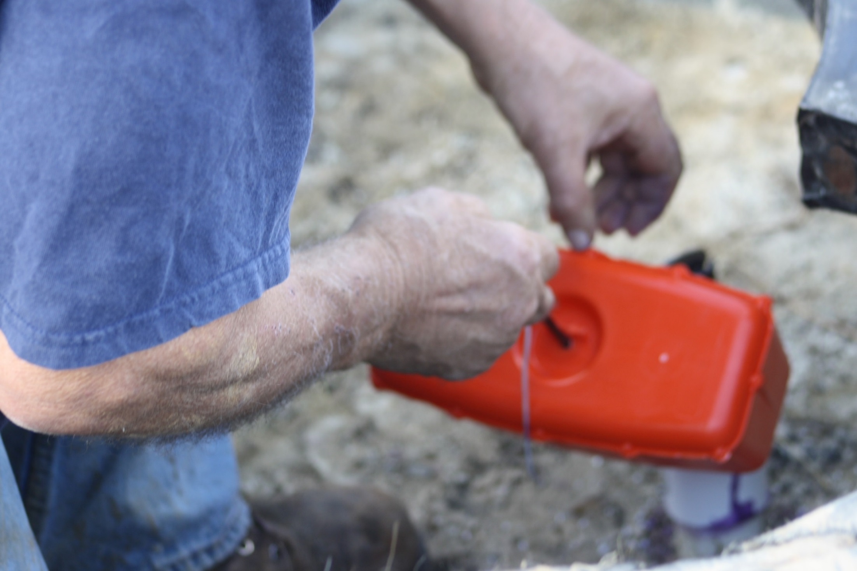
Attaching the float to the valve.

Slide 48
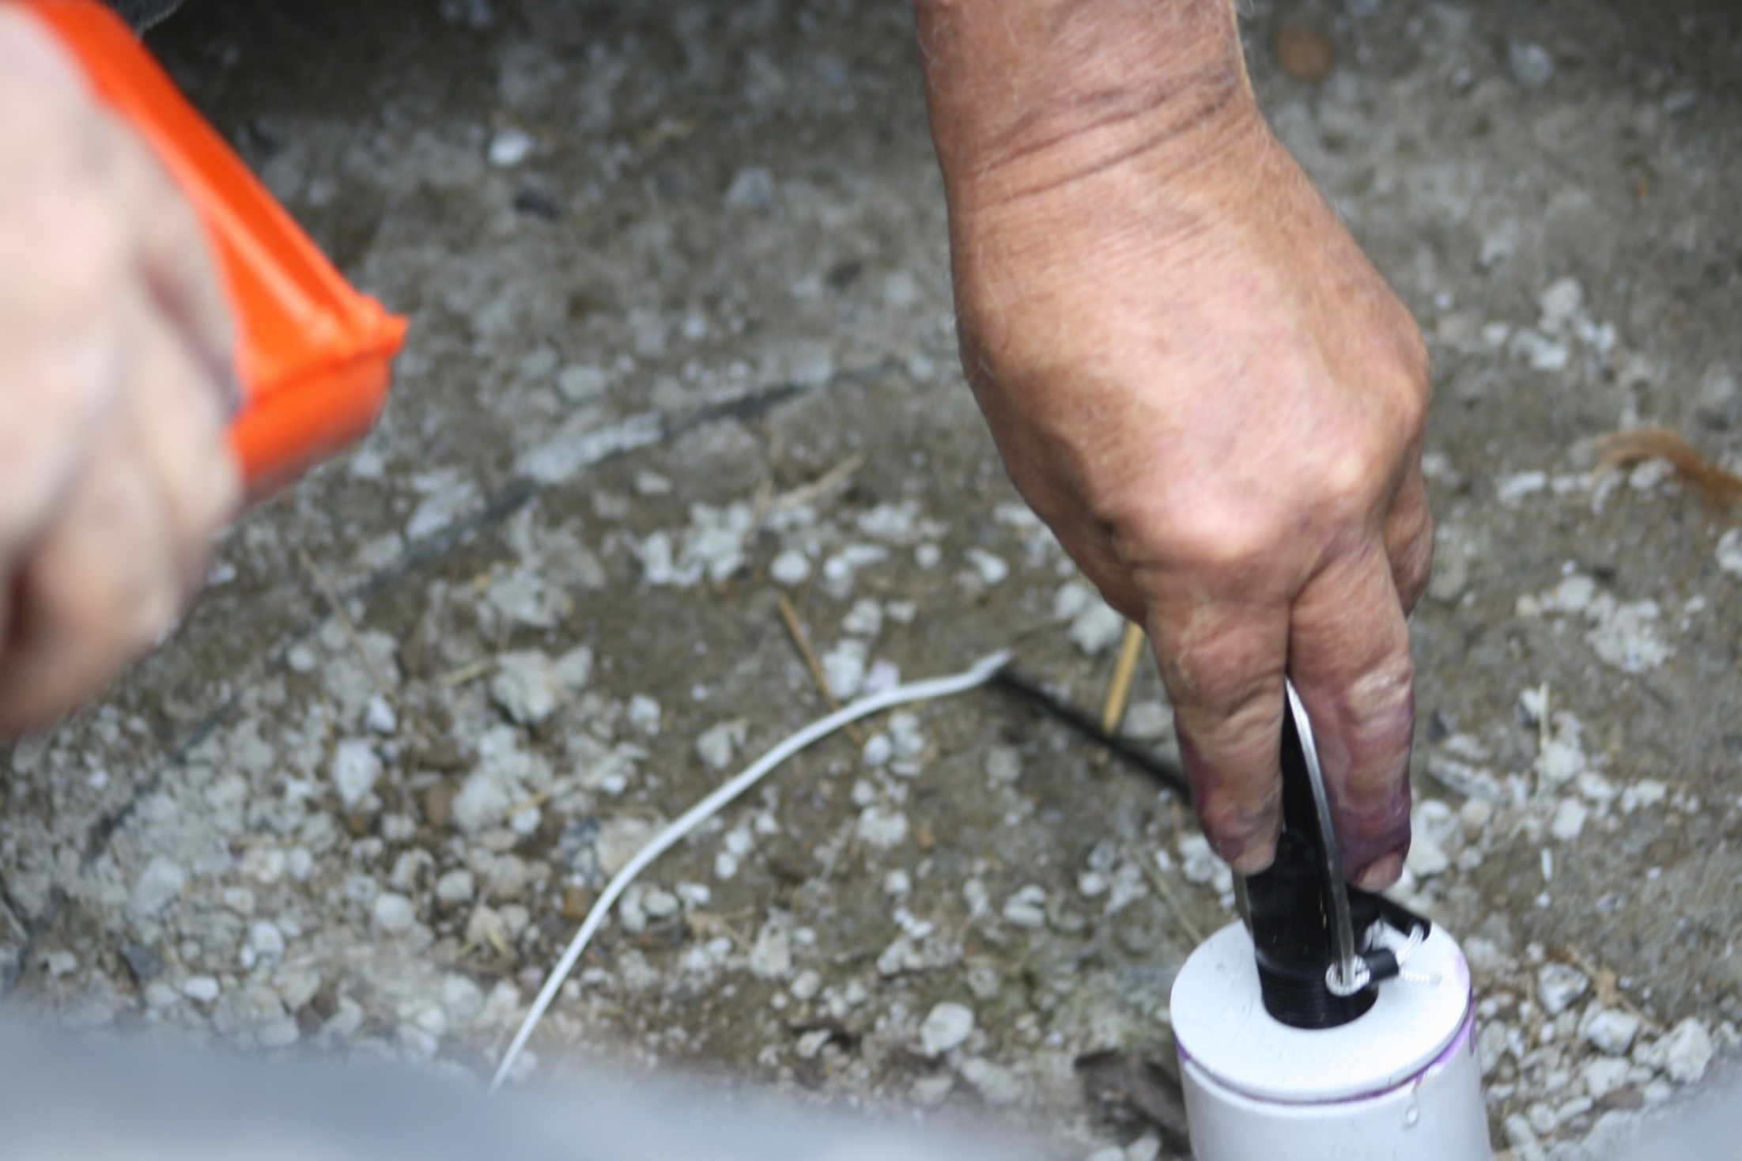
Float wire length is adjusted later to prevent overflow.

Slide 49
Visit NRCS for additional information

